Slide 1


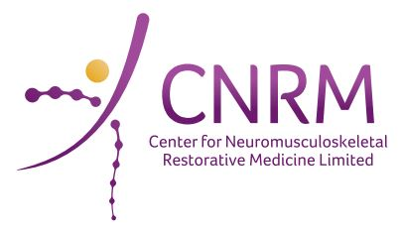
Somatic Mutational Landscape of RNA Binding Protein (RBP) Genes Across Cell Types/Tissues during Mouse Aging
Presenter: Gexin Liu
E-mail: GexinLiu@link.cuhk.edu.hk
Supervisor: Prof. Huating Wang
Department: Department of Orthopaedics and Traumatology
University: The Chinese University of Hong Kong
Date: 2024/11/02
Time: 07:45 - 10:00
Meeting Room: s426
Presentation Code: 3.15

Slide 2
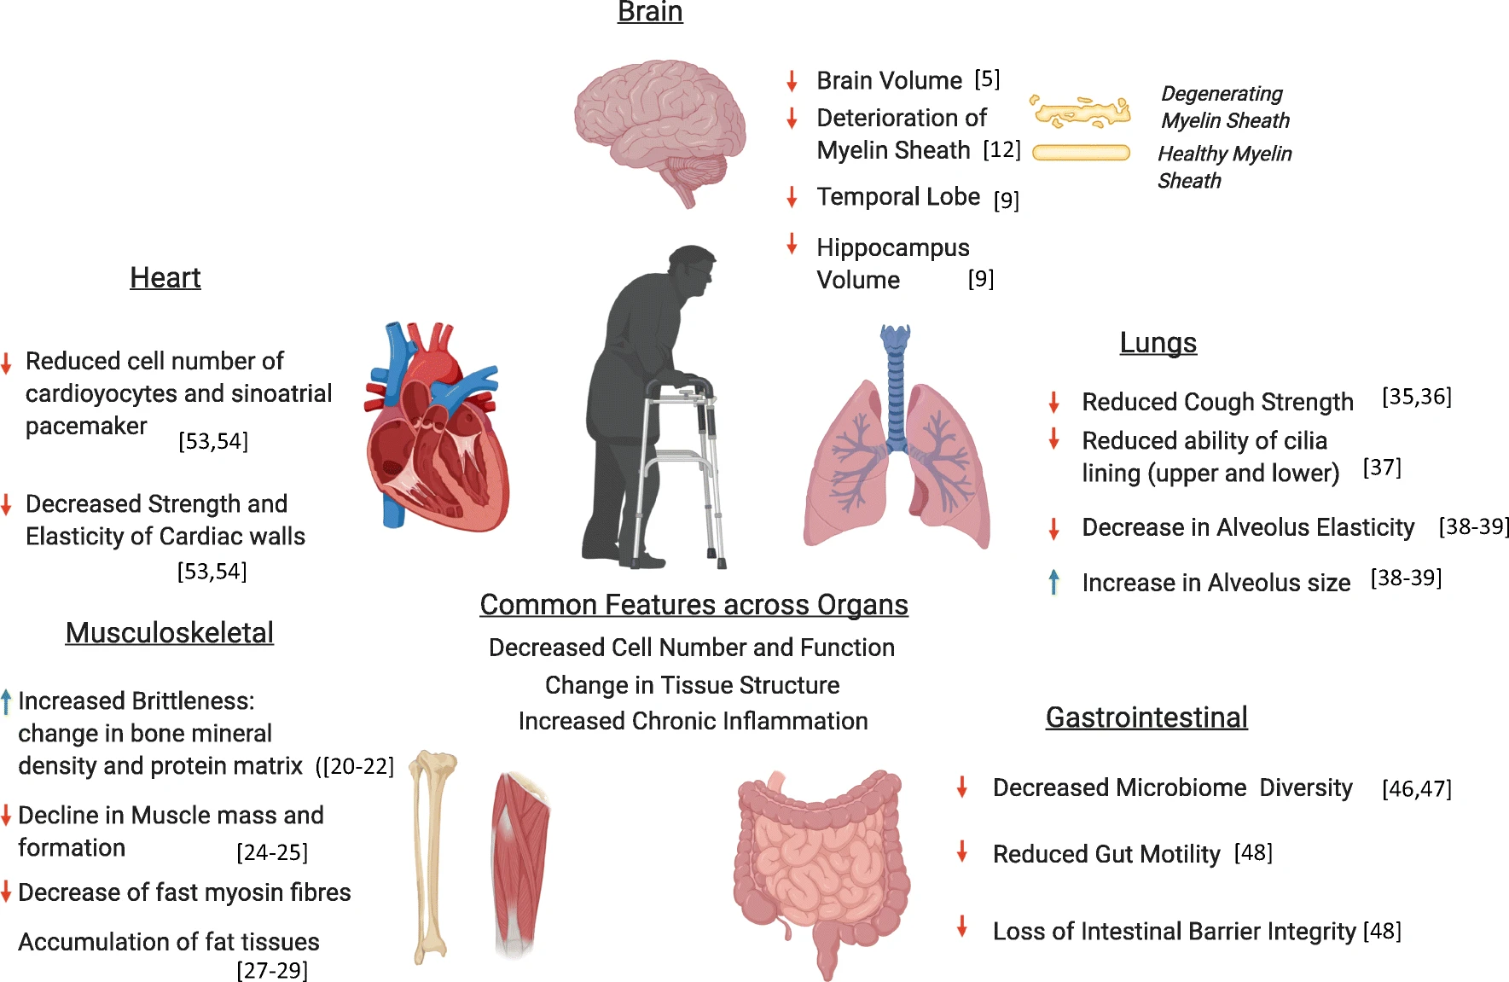

Background
Aging Leads to the Decline of Organ Function
(Xu, Wong et al. 2020)

Slide 3
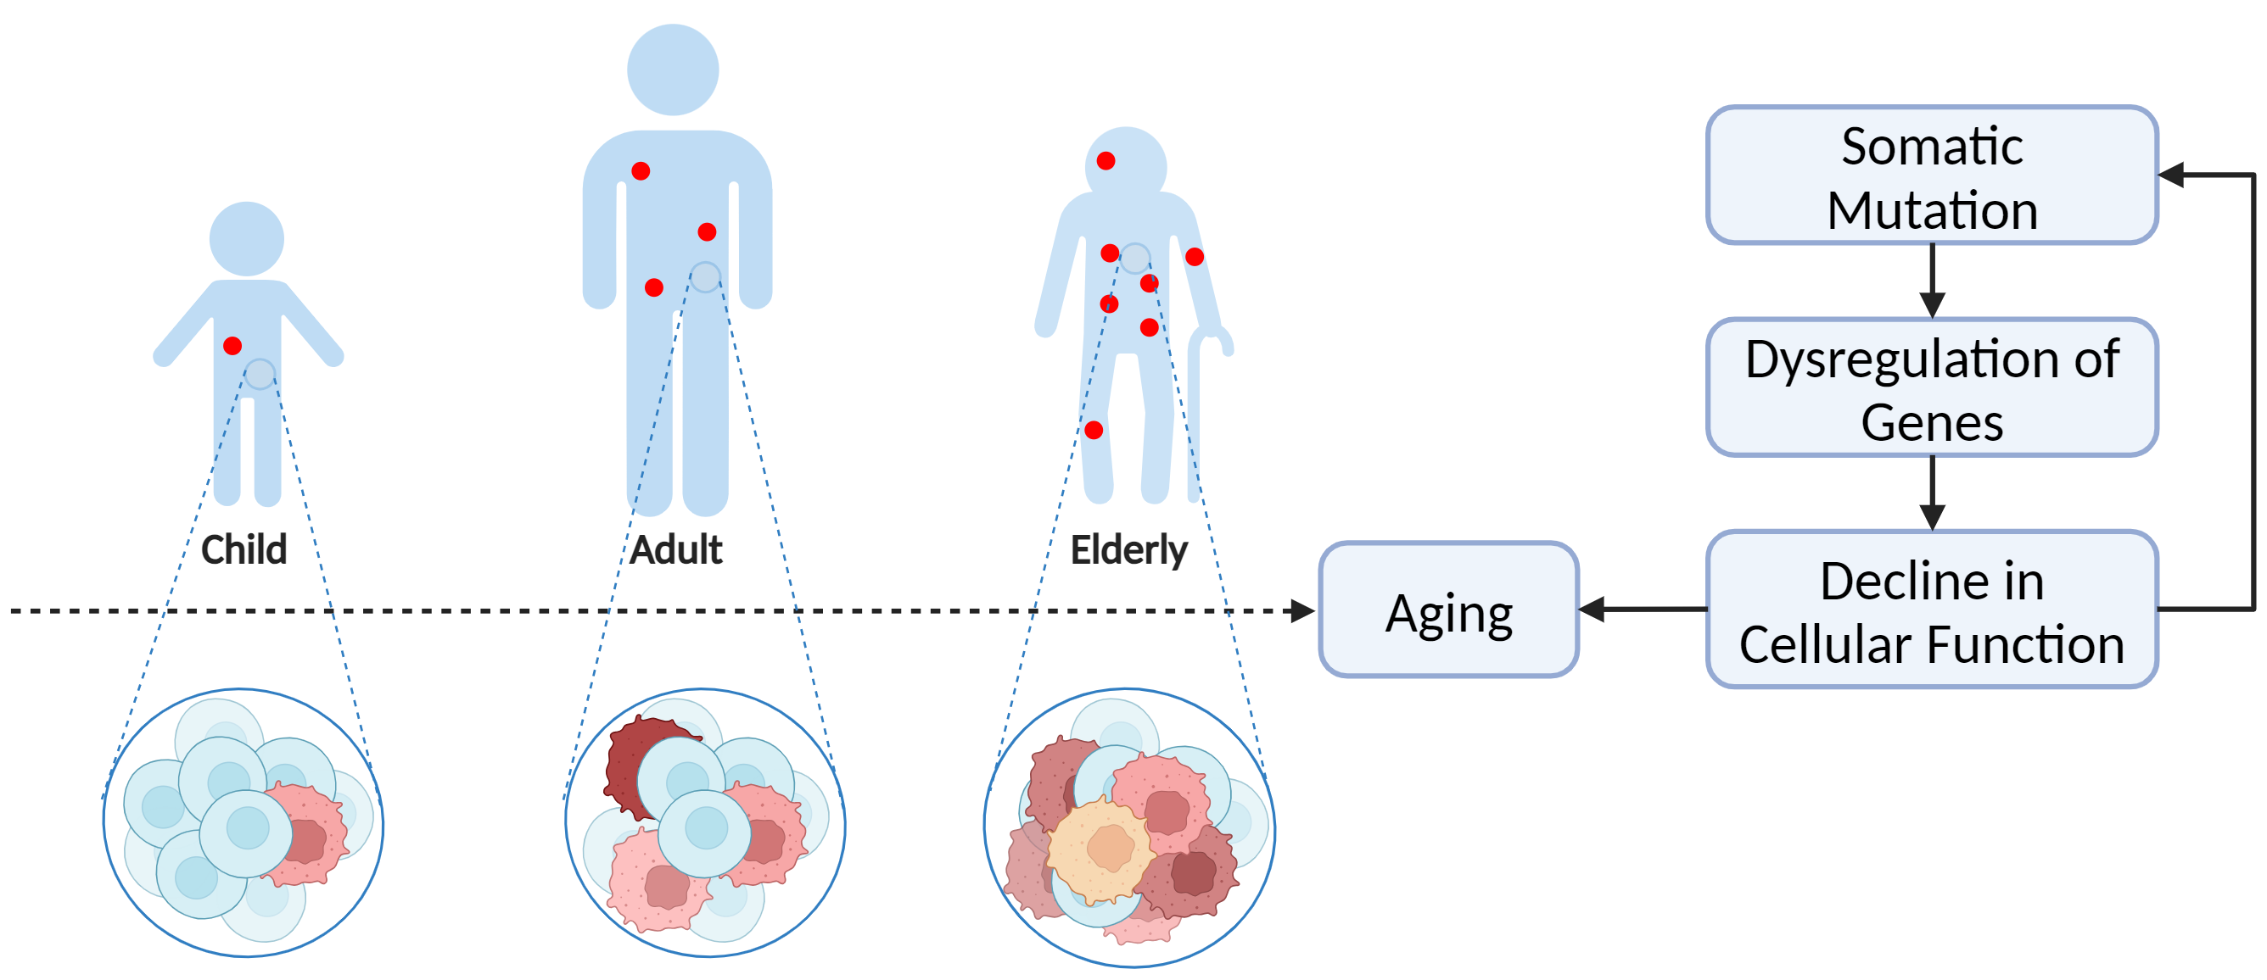
Background
Somatic Mutations Accumulate with Aging
Many researchers believe that accumulating somatic mutations are a significant cause of aging.

Slide 4
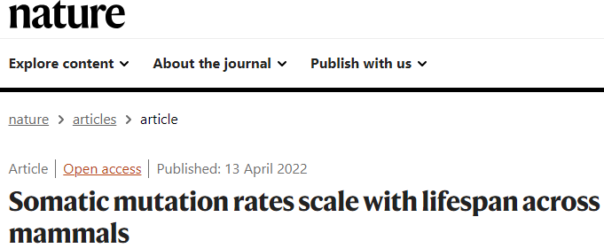
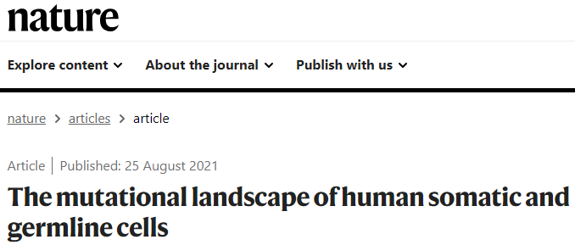
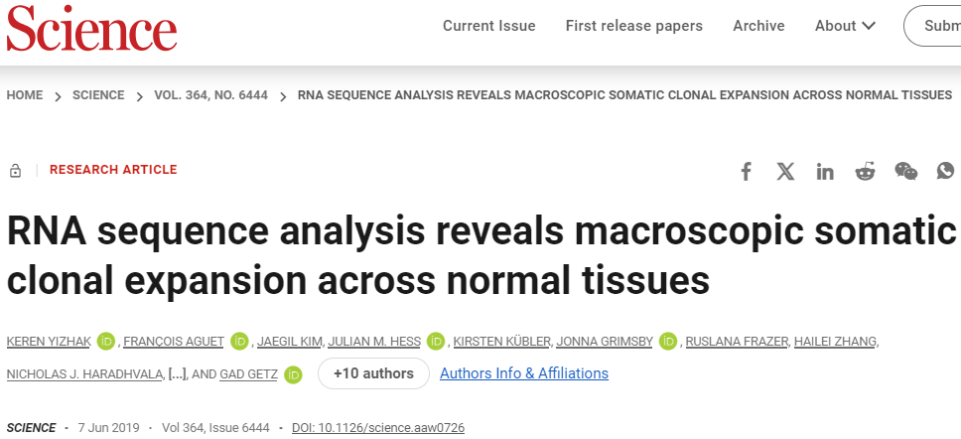
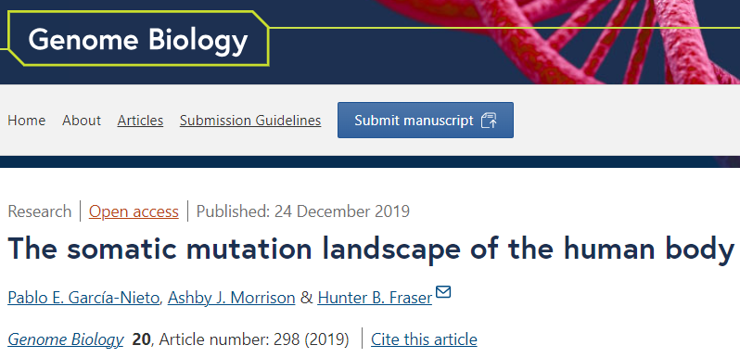
Background
Exploring Mutations and Aging: Examples from Scientific Research
However, limited studies focus on the somatic mutations occurring on specific functional genes, such as RNA-binding proteins.

Slide 5
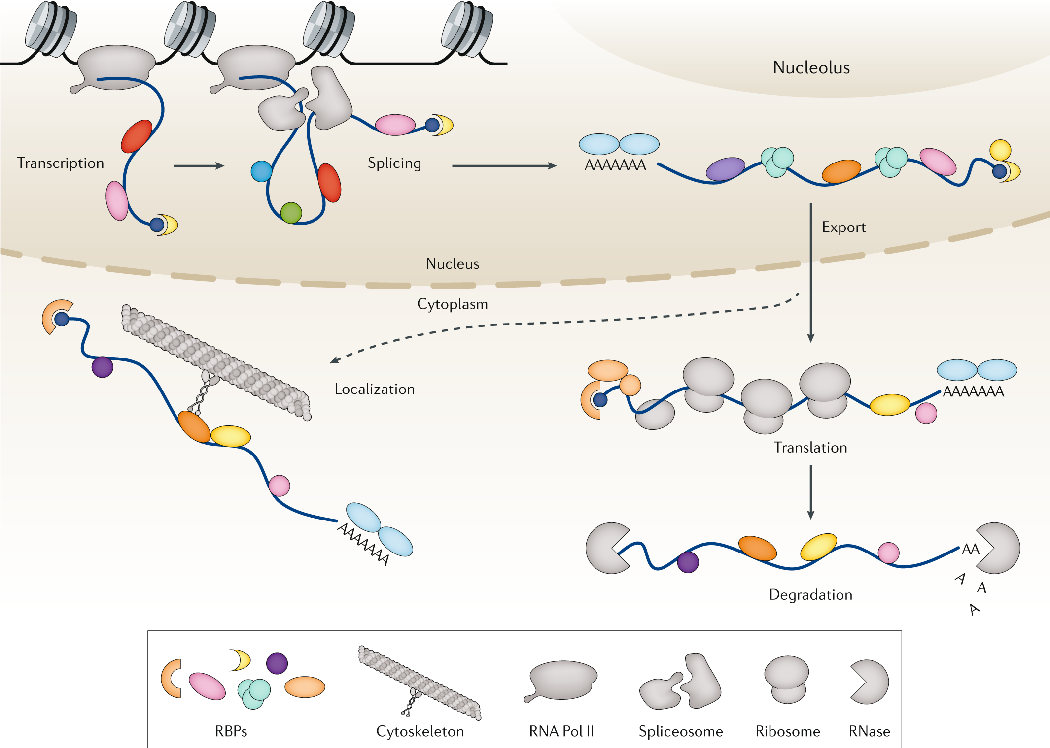
Background
RBPs Play Important Roles in Post-transcription Regulation
RNA-binding proteins (RBPs) are a class of proteins that regulate various aspects of RNA metabolism, including RNA processing, transport, stability, and translation, through their interaction with RNA molecules.
(Gebauer, Schwarzl et al. 2021)
Notes:
RBPs bind to RNA-binding motifs of the target transcripts and are involved in post-transcriptional processes such as RNA transport, stabilization, splicing, and decay.

Slide 6
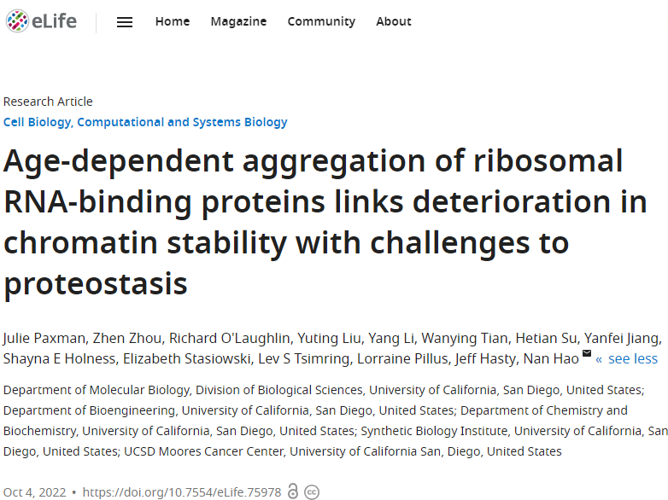
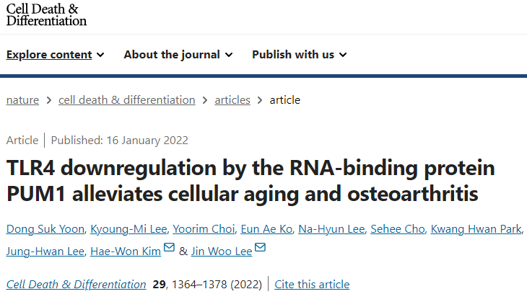
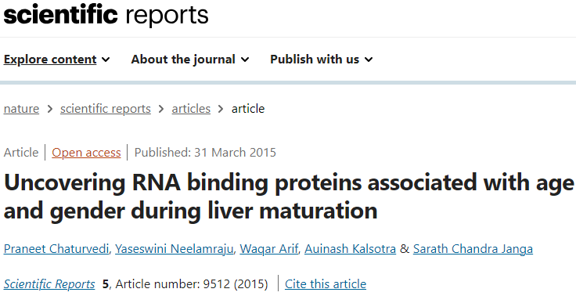
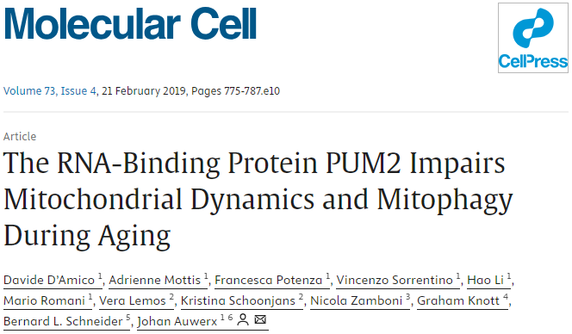
Background
Studies Exploring the Role of RBPs in Aging

Slide 7
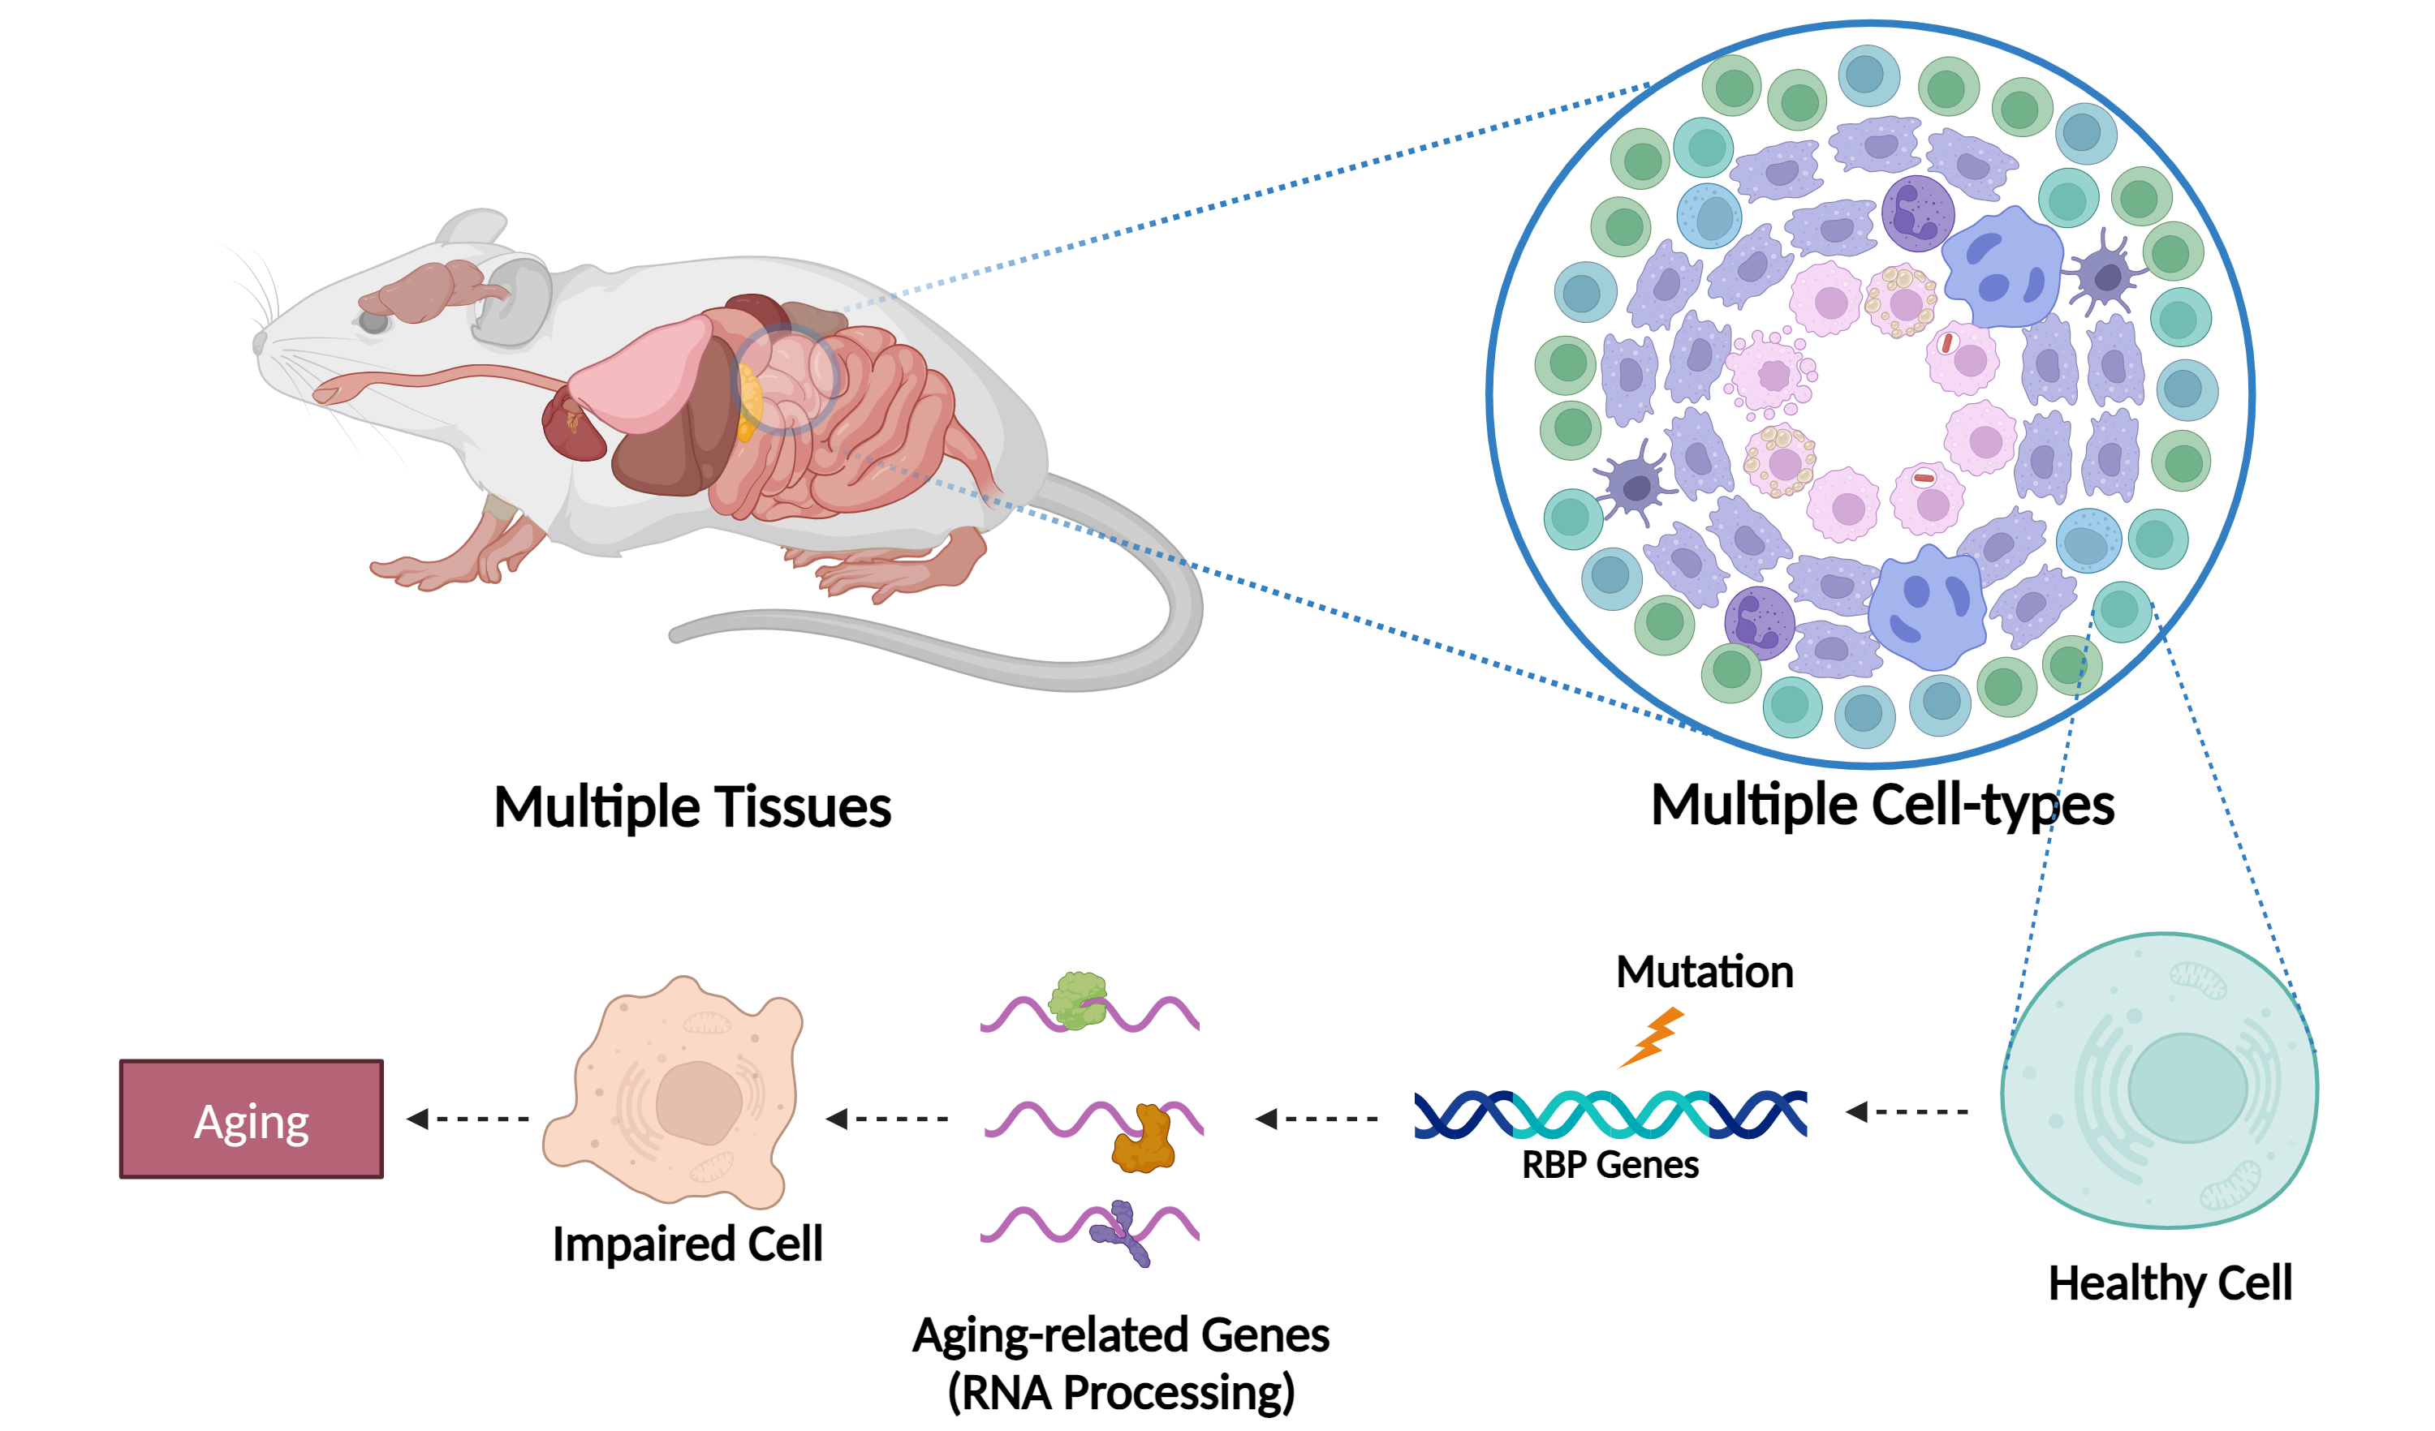
Hypothesis
Somatic Mutations in RBPs May Influence Aging

Slide 8
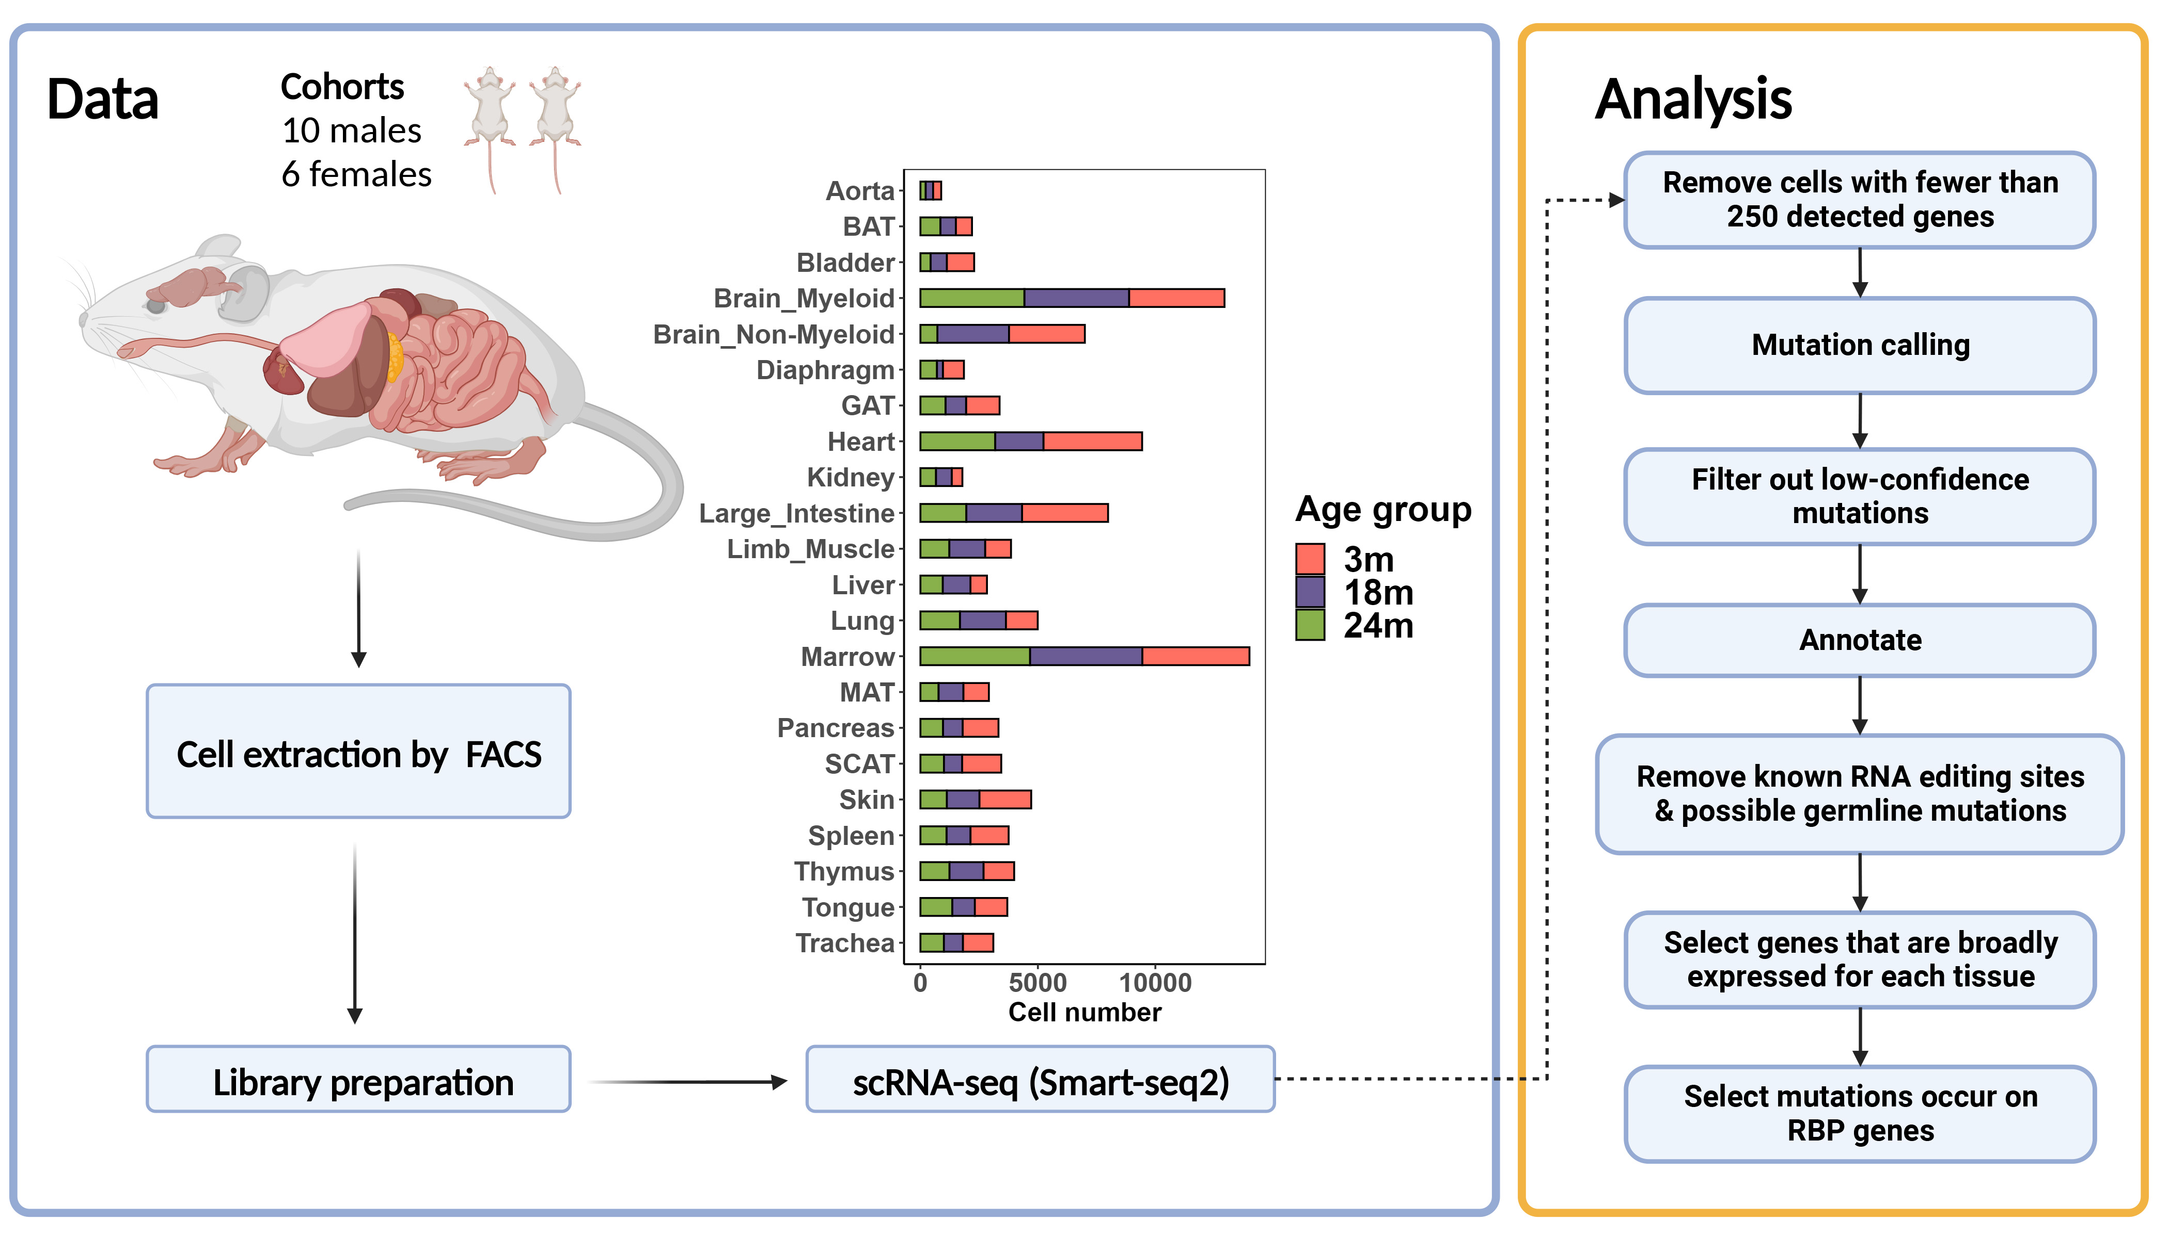
Methodology
Somatic Mutation Analysis Using a Public scRNA-seq Dataset

Slide 9
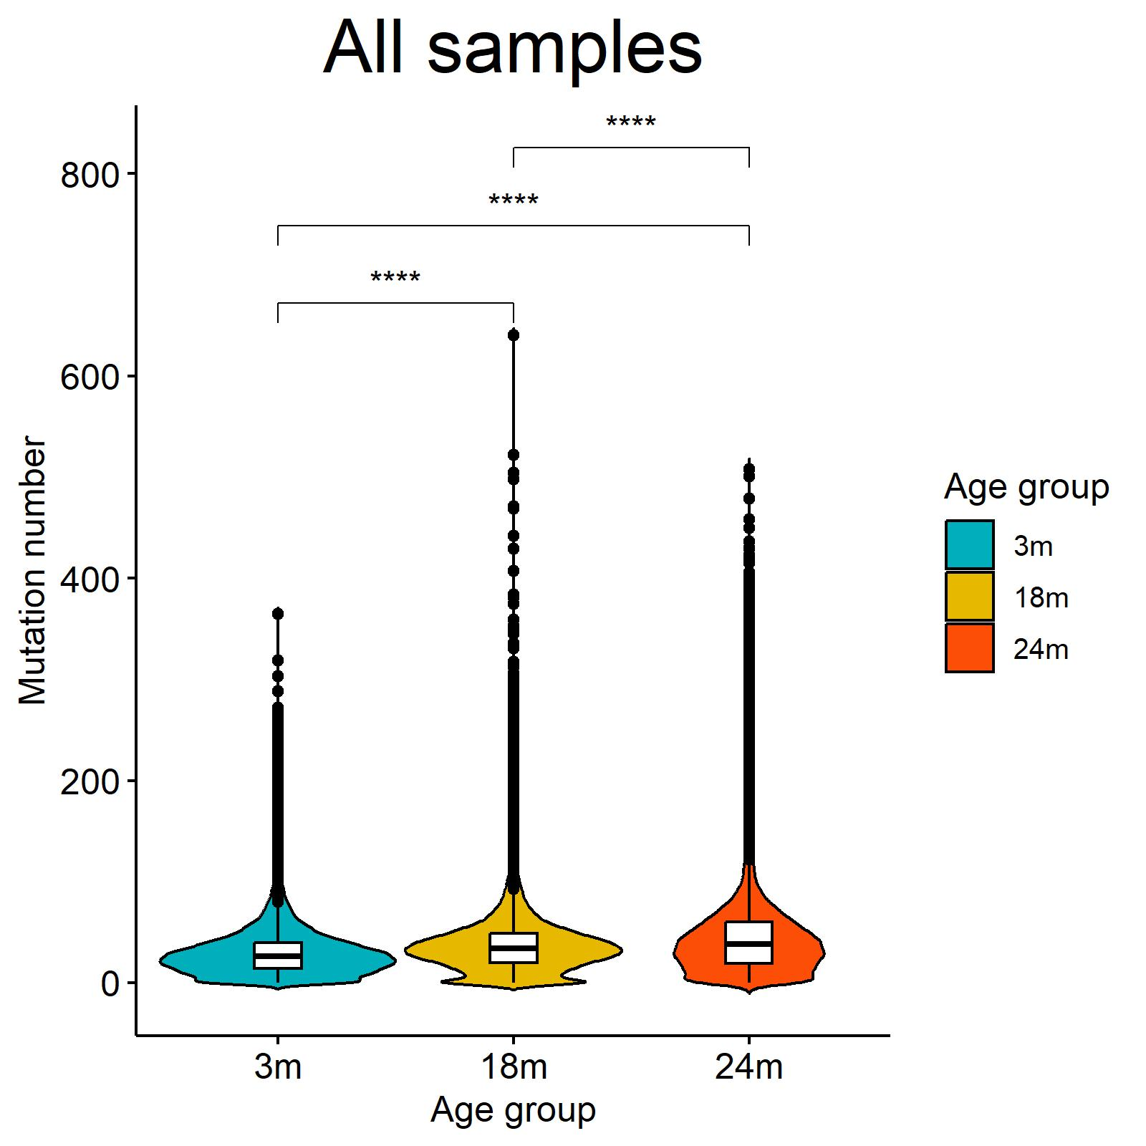
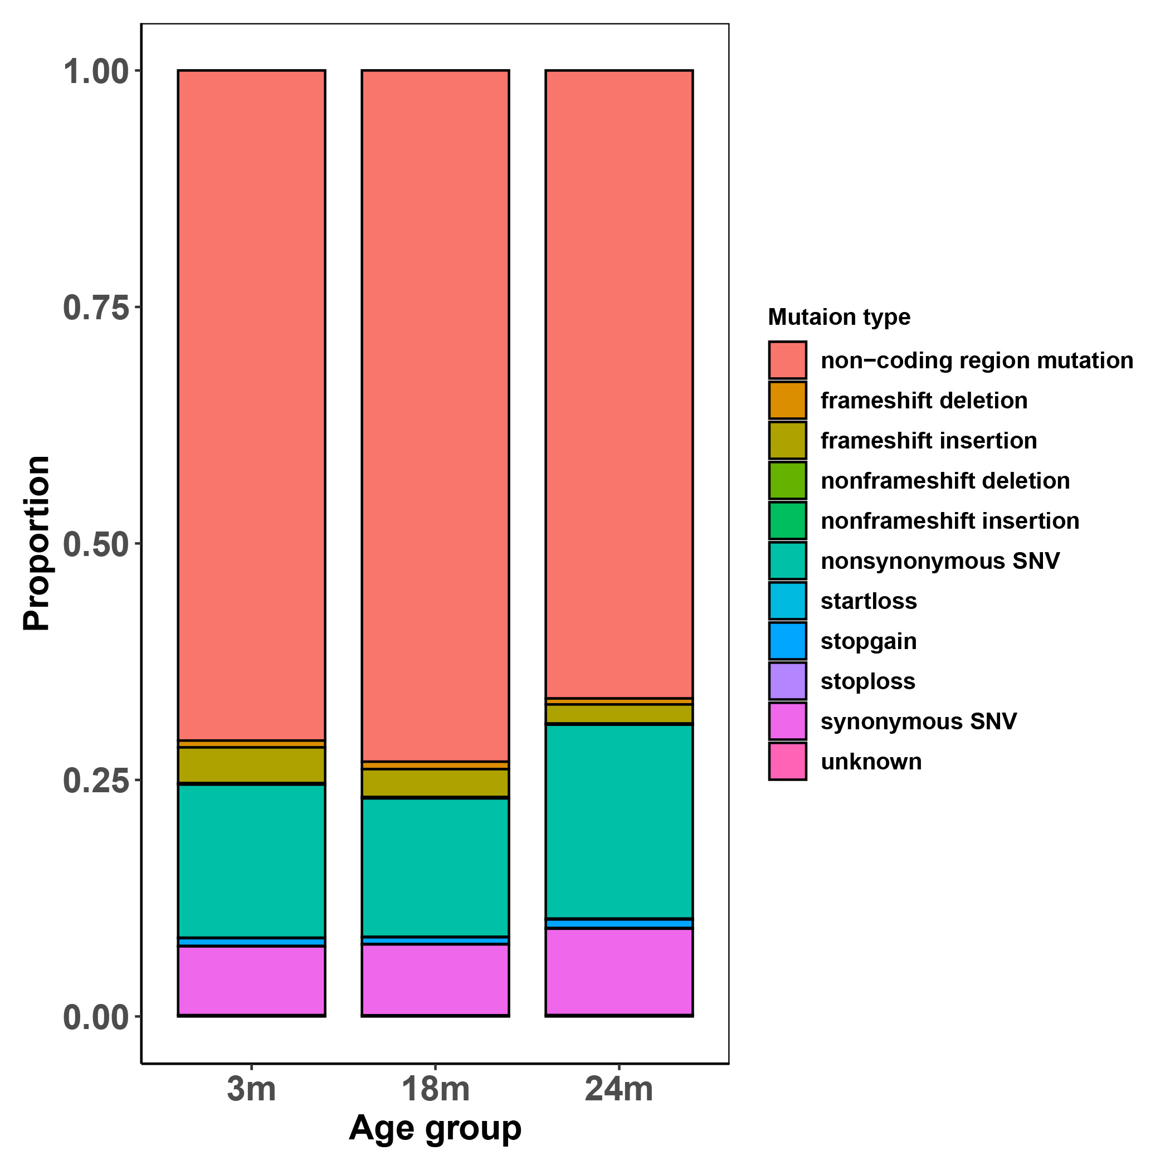
Results
An Overview of Identified RBP Mutations
Mutation category
The number of RBP mutations basically increases with aging.
RBP mutation categories vary with aging.

Slide 10
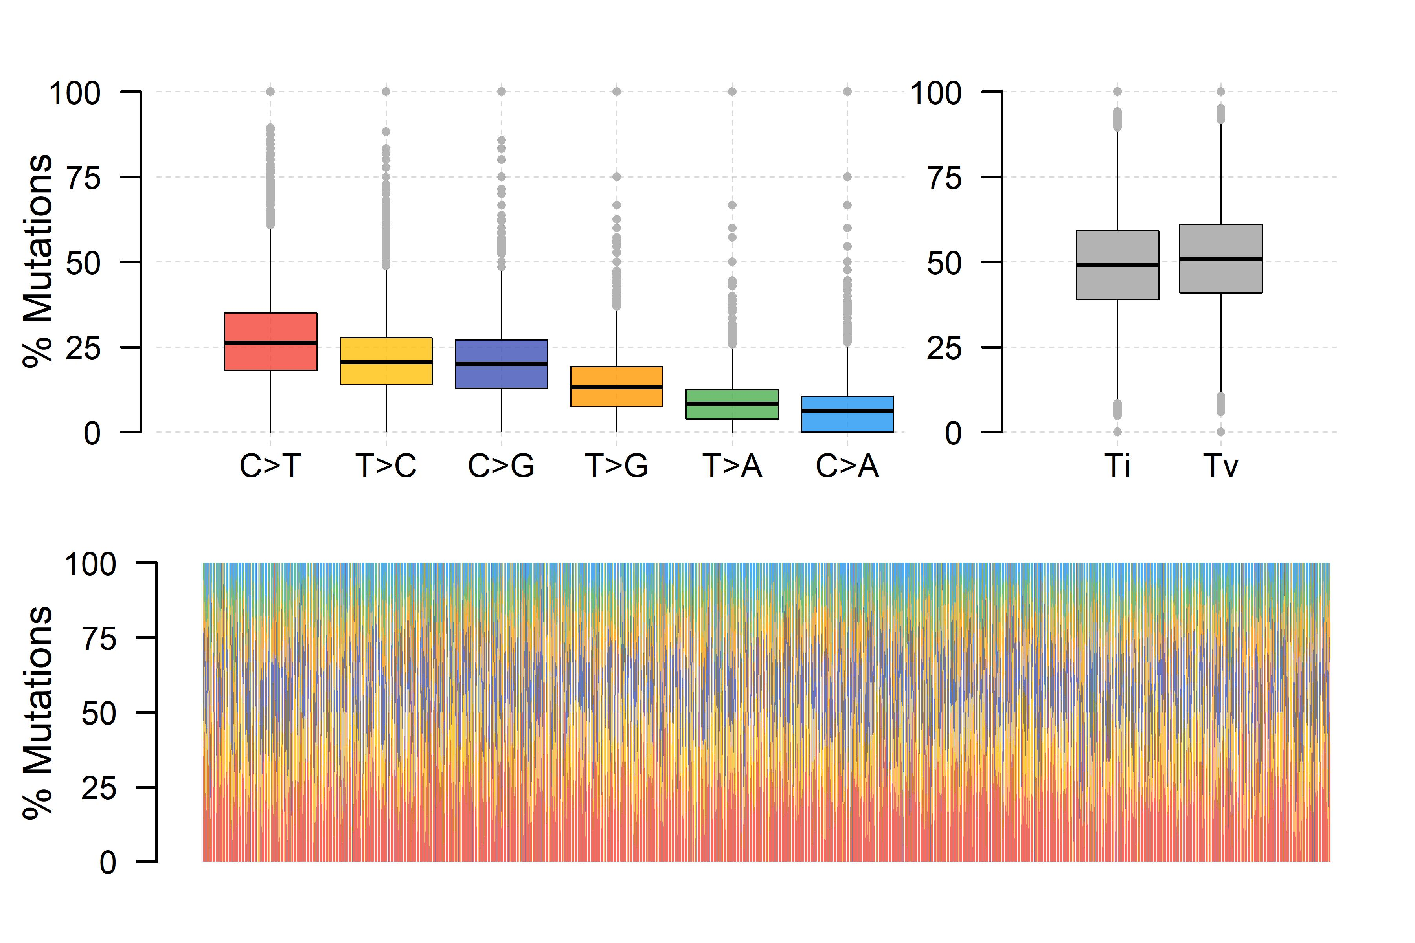
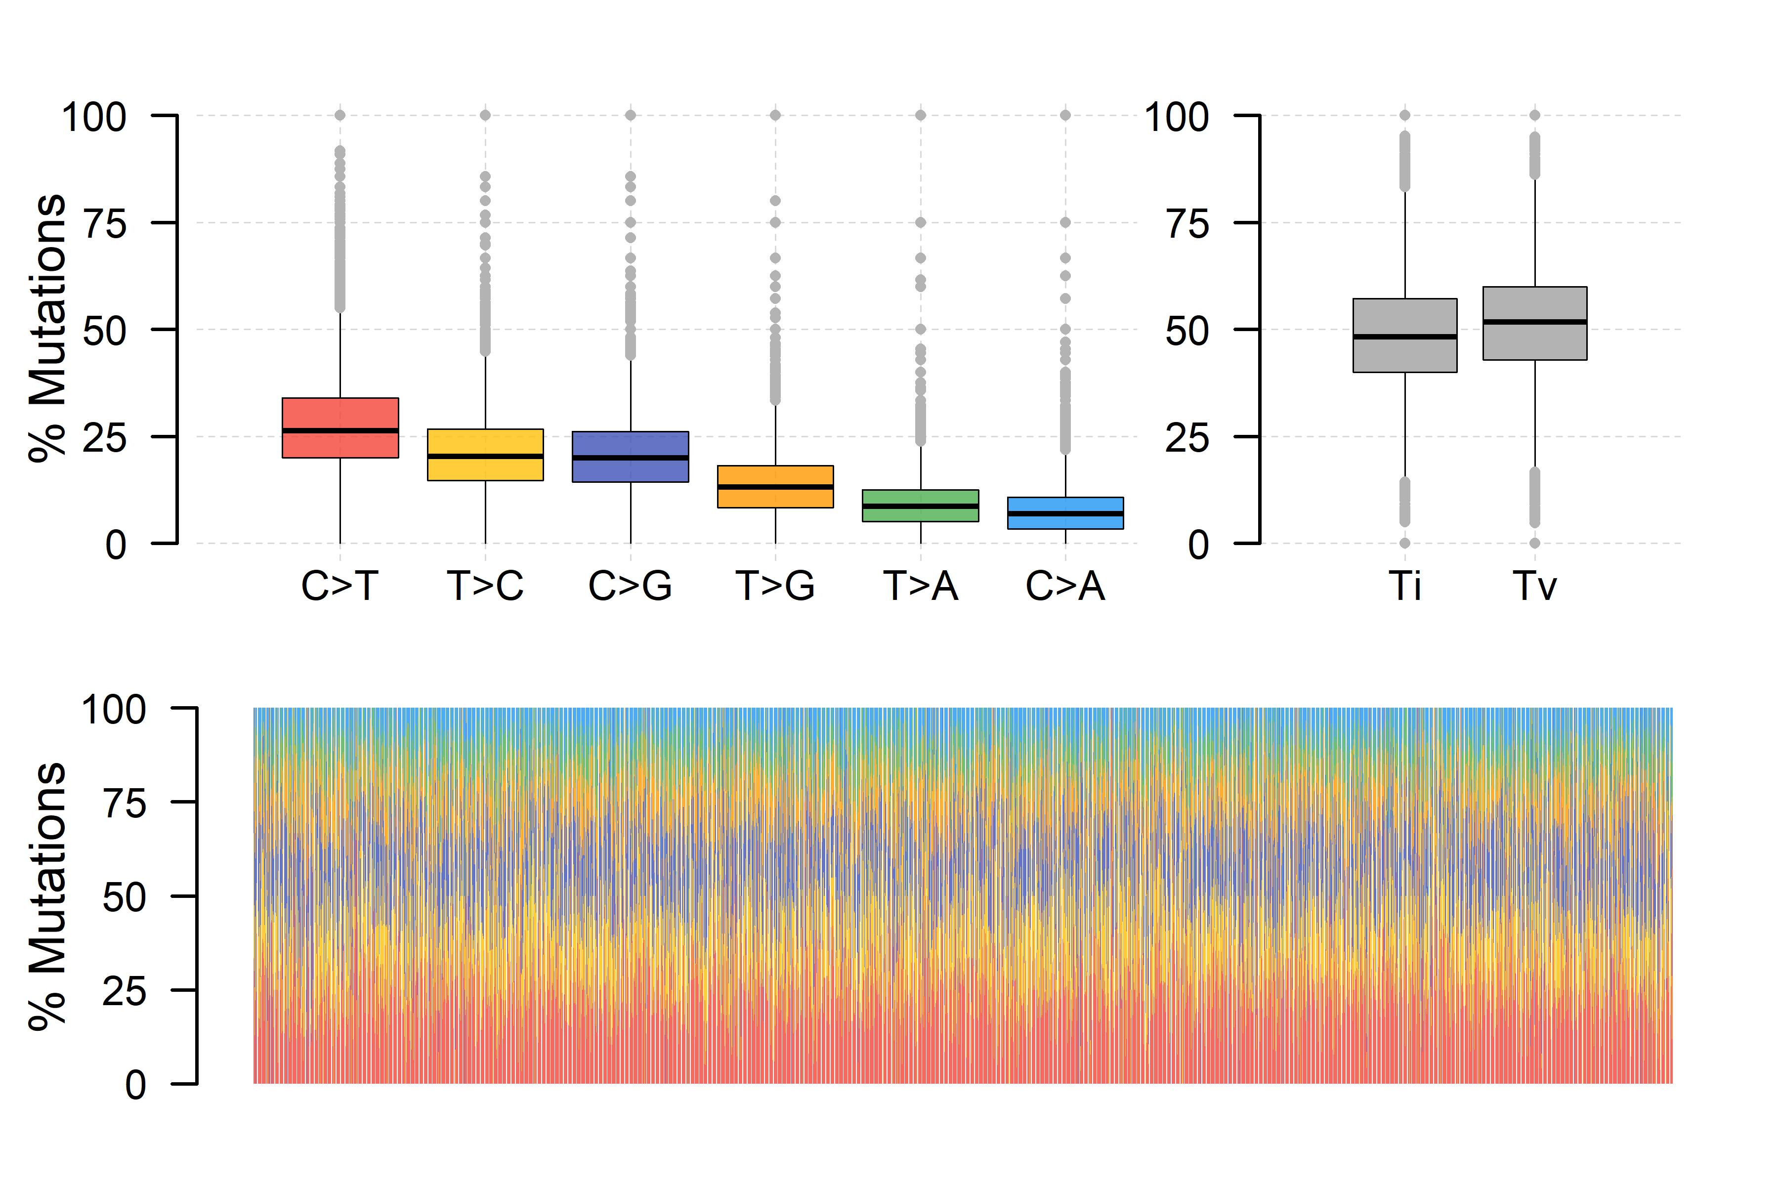
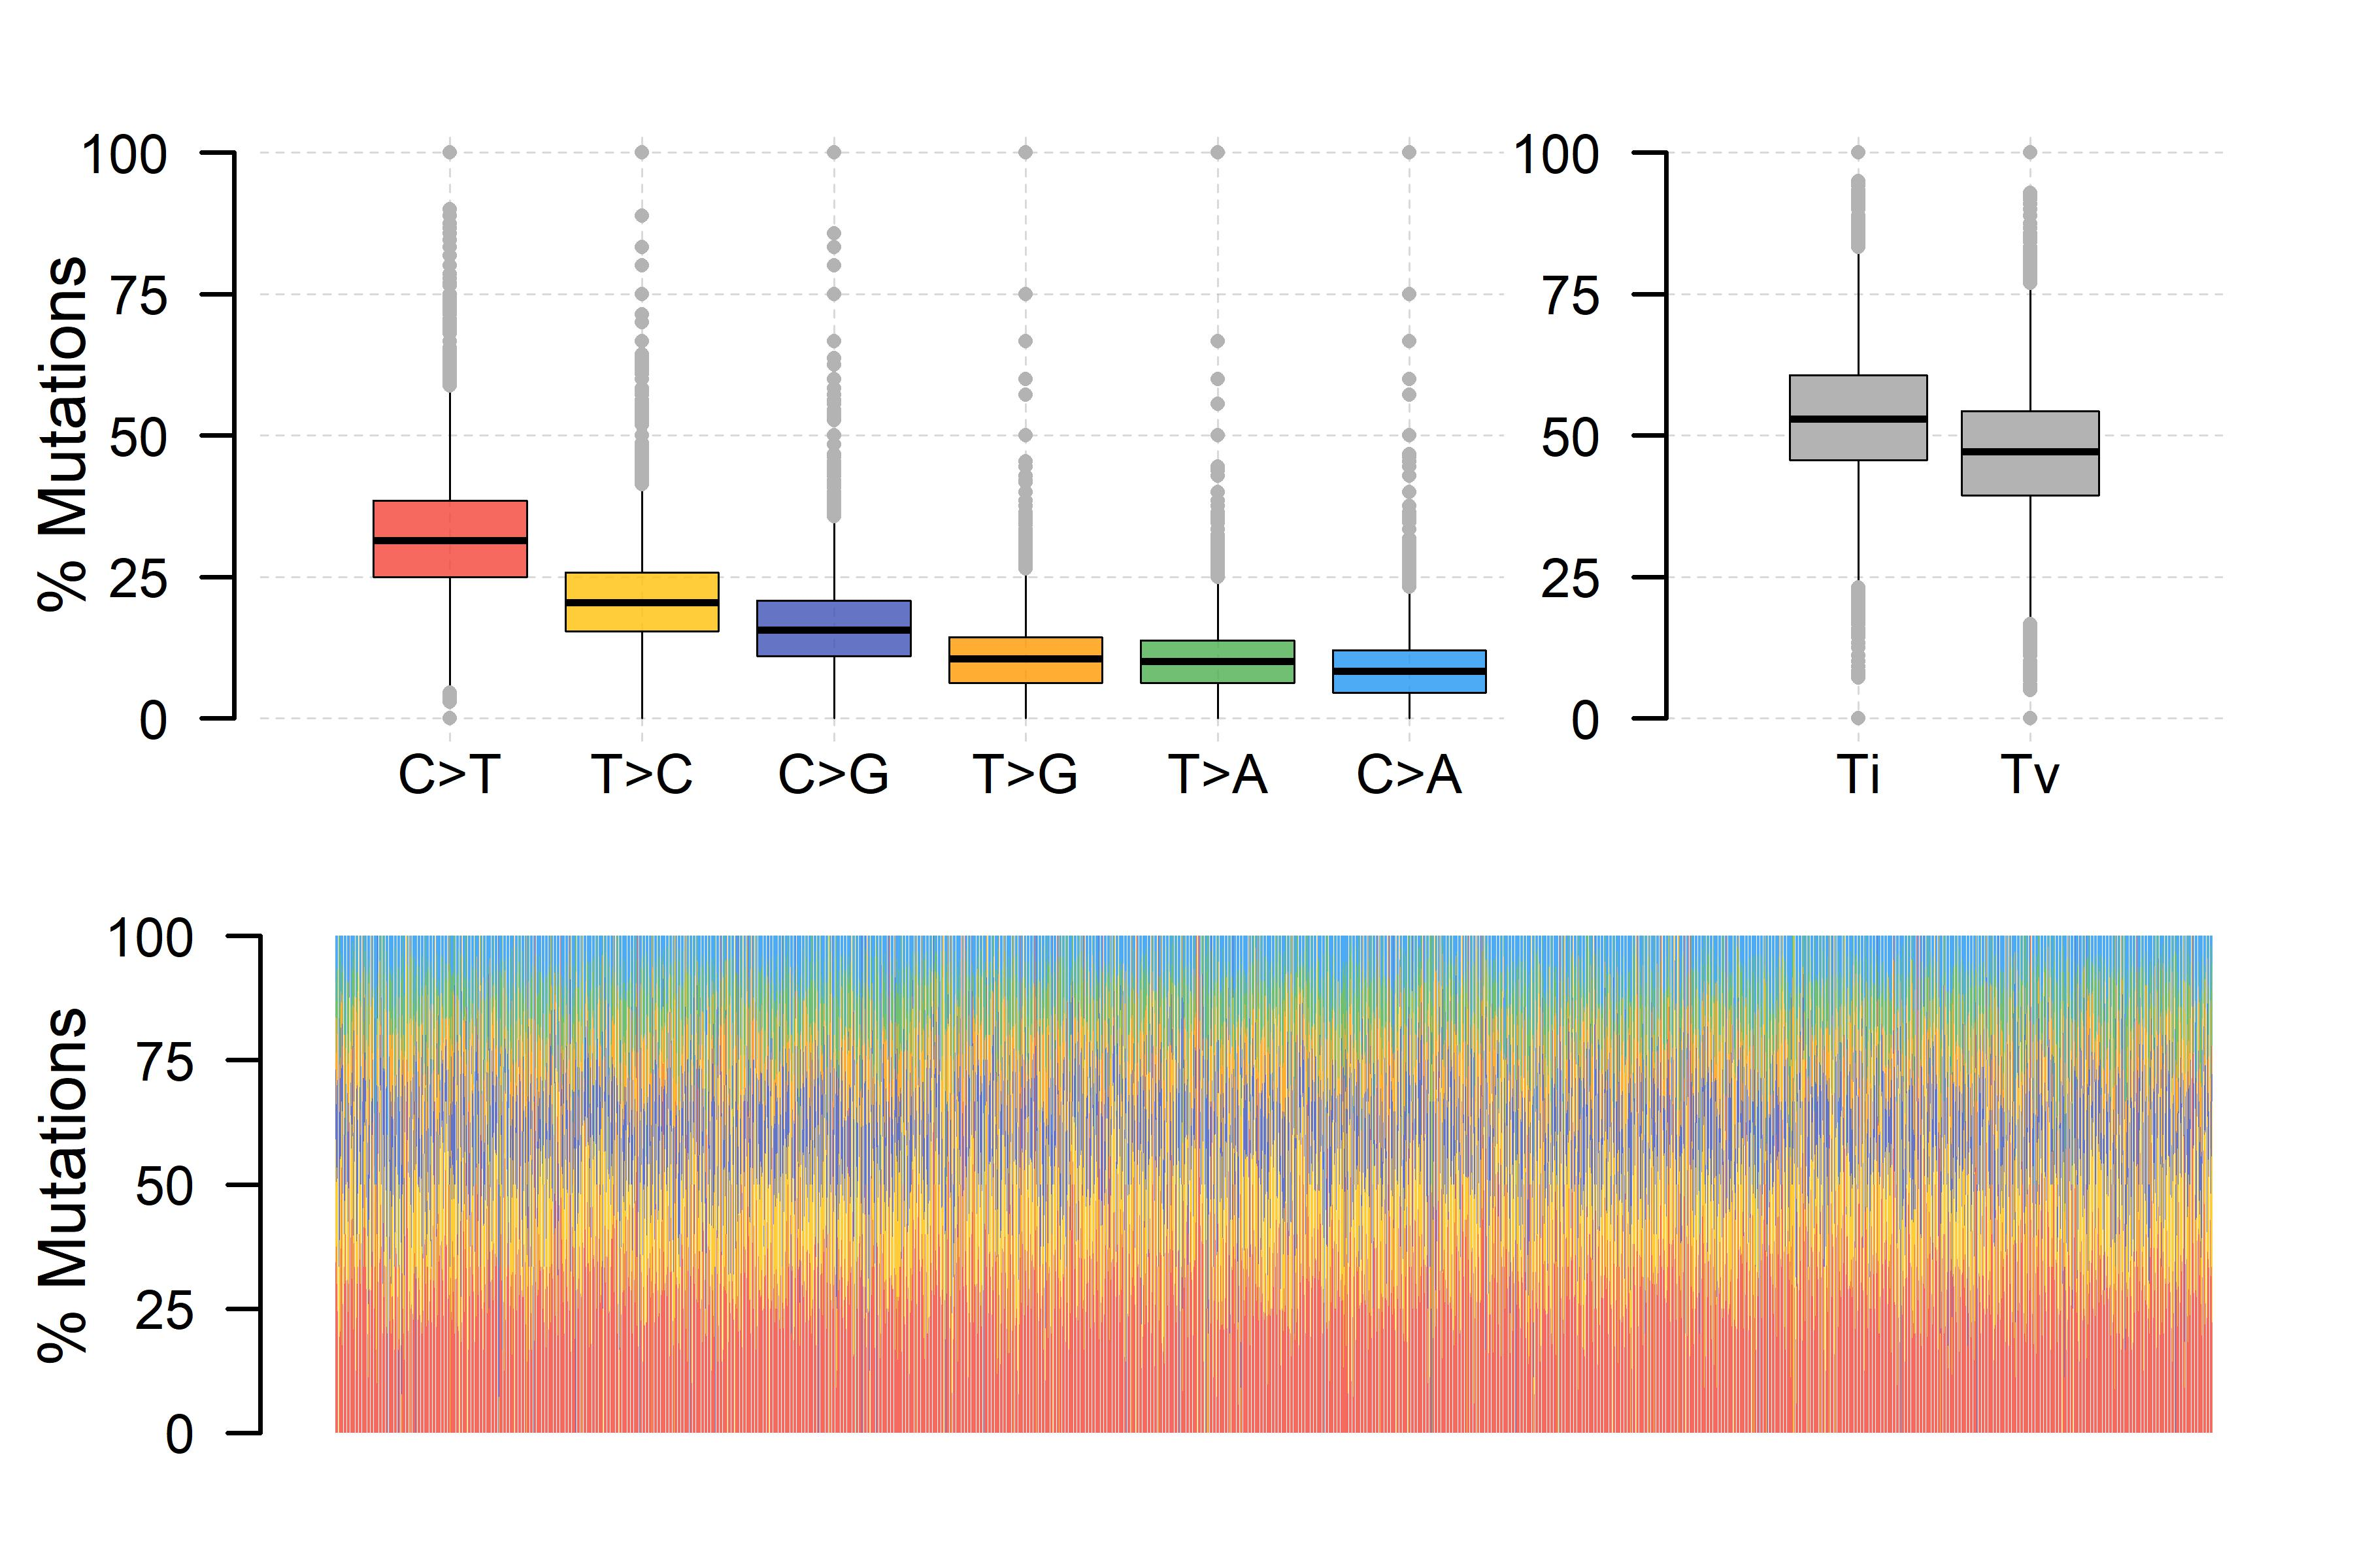
Results
An Overview of Identified RBP Mutations
Ti (Transition mutation): A ↔ G, or C ↔ T.
Tv (Transversion mutation): A/G ↔ C/T.
3m
18m
24m
In the 24-month-old age group, the proportion of ‘C > T’ mutations is higher compared to the other two age groups.
In the 24-month-old age group, ‘transversion mutations’ occur at a higher proportion than ‘transition mutations’.

Slide 11
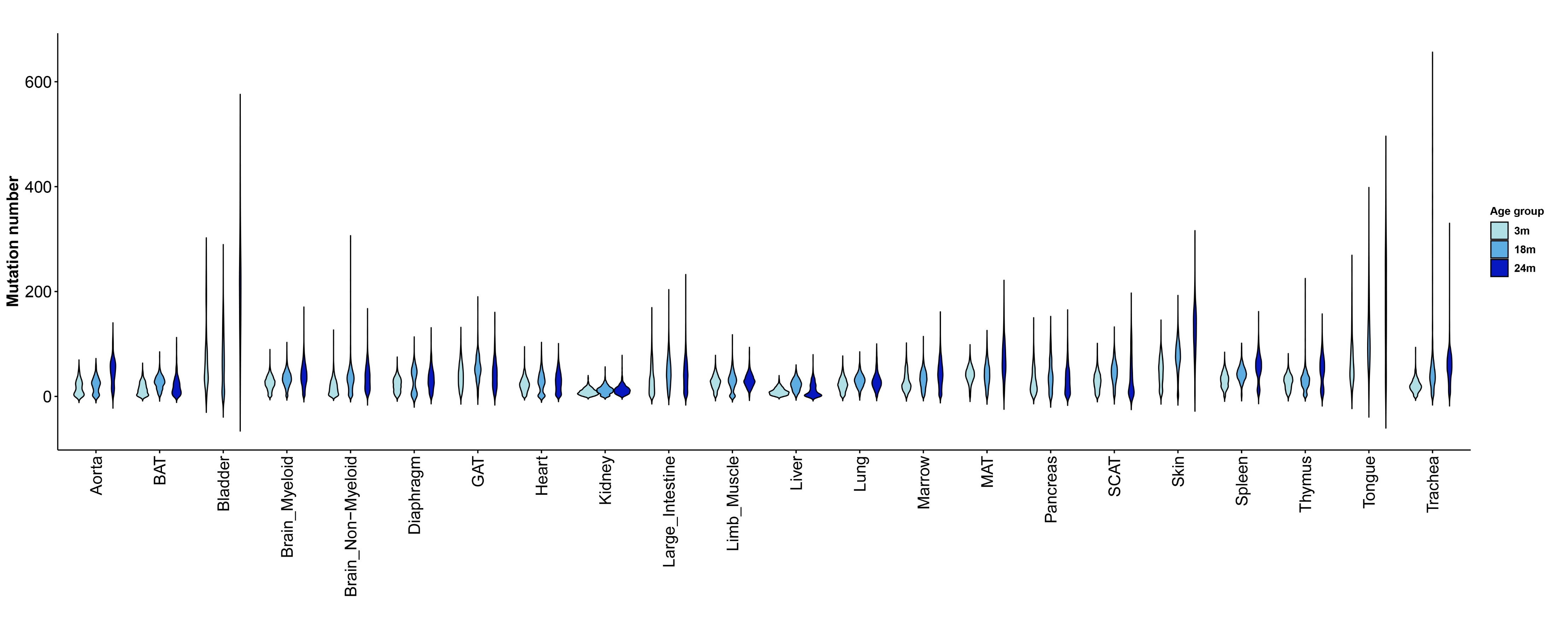
Results
Variation in RBP Mutation Dynamics Across Tissues with Aging
Certain tissues, such as the skin, spleen and tongue, exhibit a significant increase in RBP mutations with aging.
In certain tissues, like the heart and limb muscle, there is little change in the number of RBP mutations with aging.

Slide 12
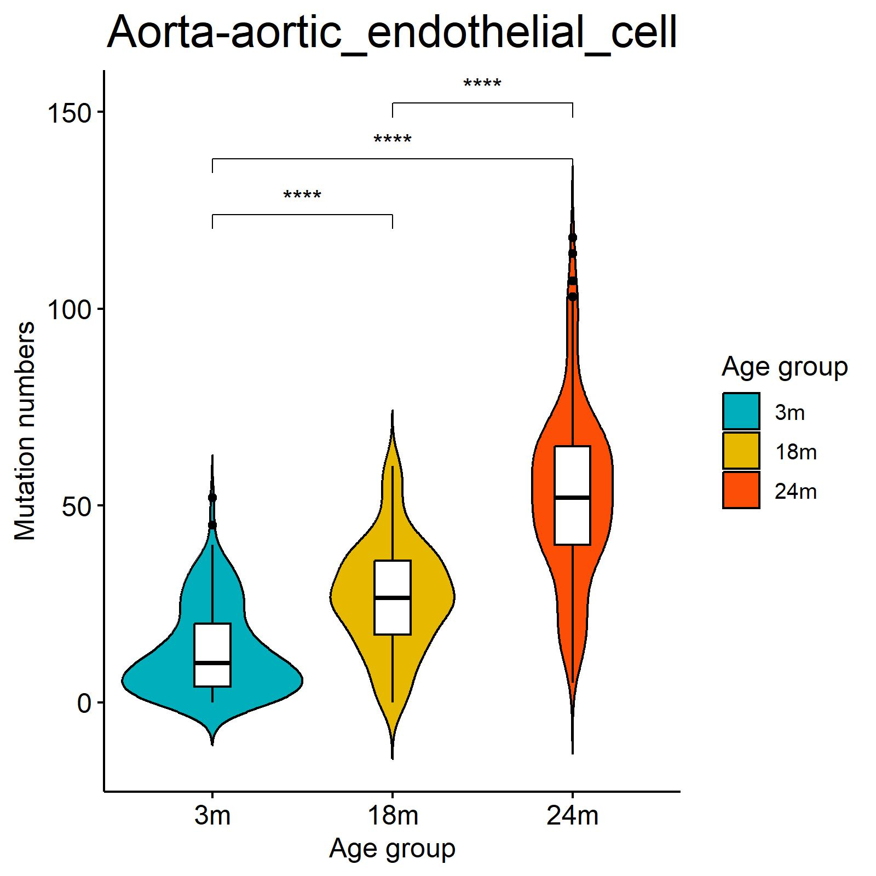
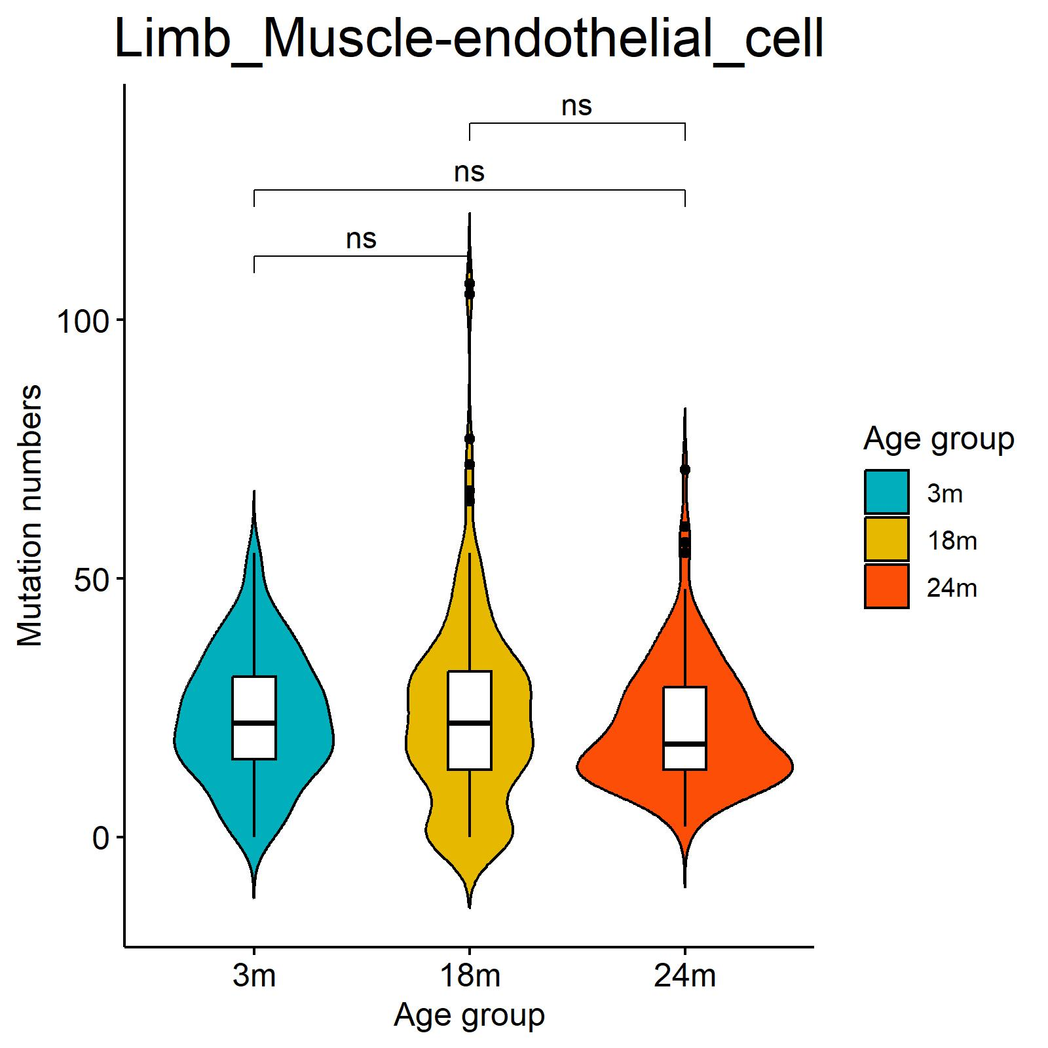
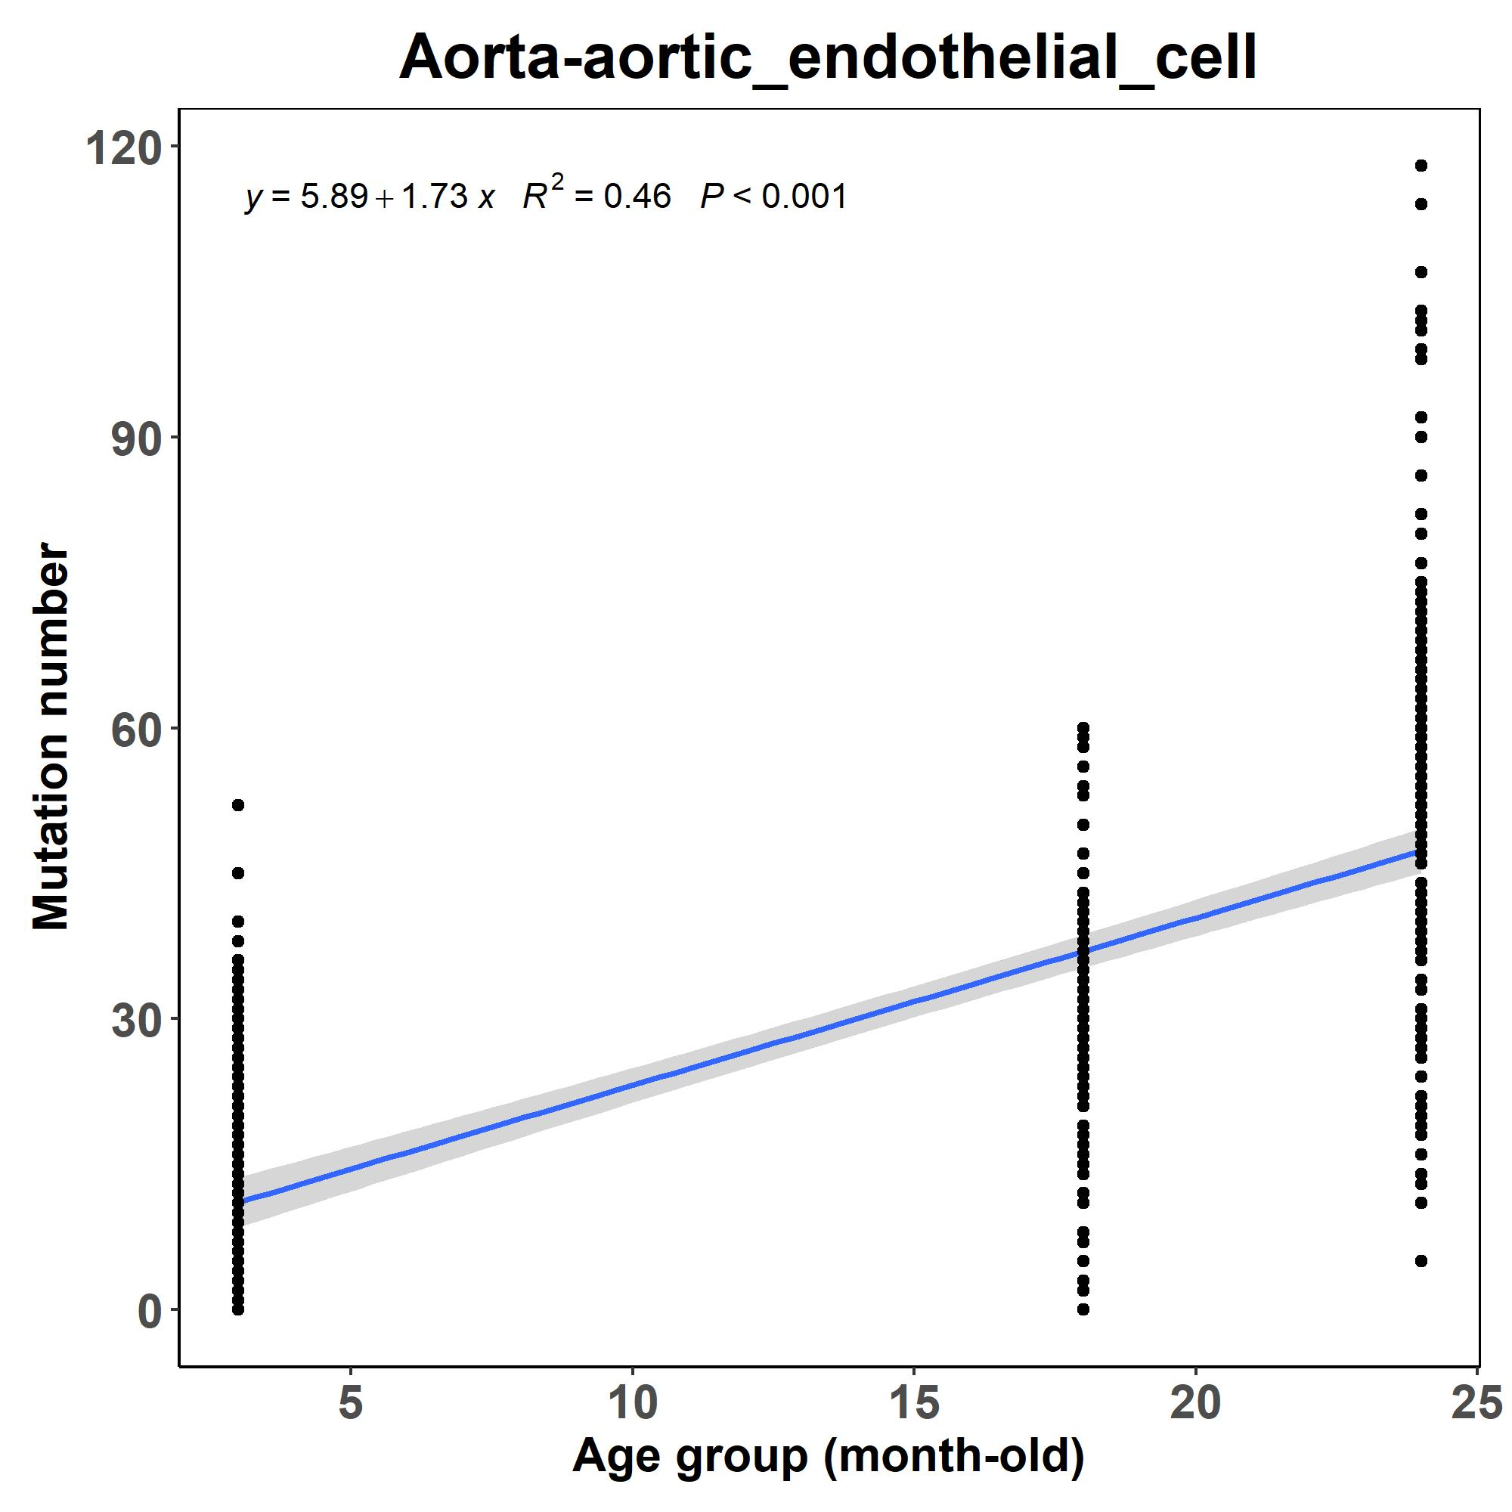
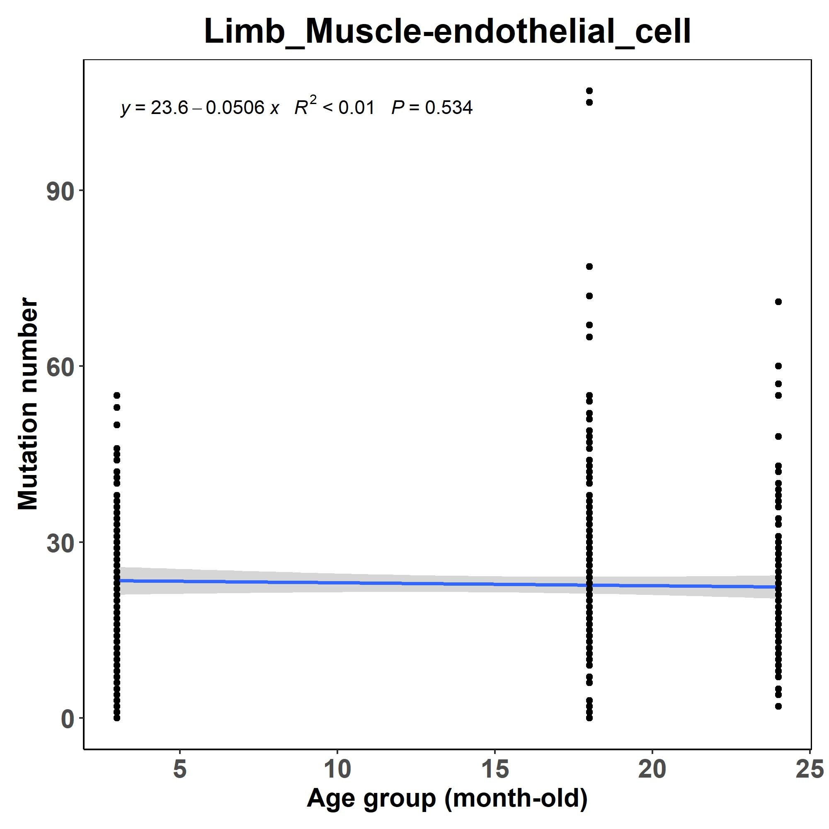
Results
Variation of RBP Mutation Rates in the Same Cell Type
Across Different Tissues
The increasing rates of RBP mutation in endothelial cell vary across different tissues during aging:
In Aorta, the number of RBP mutations shows a significant increase with aging.
In Limb Muscle, the number of RBP mutations remains nearly constant with aging.

Slide 13
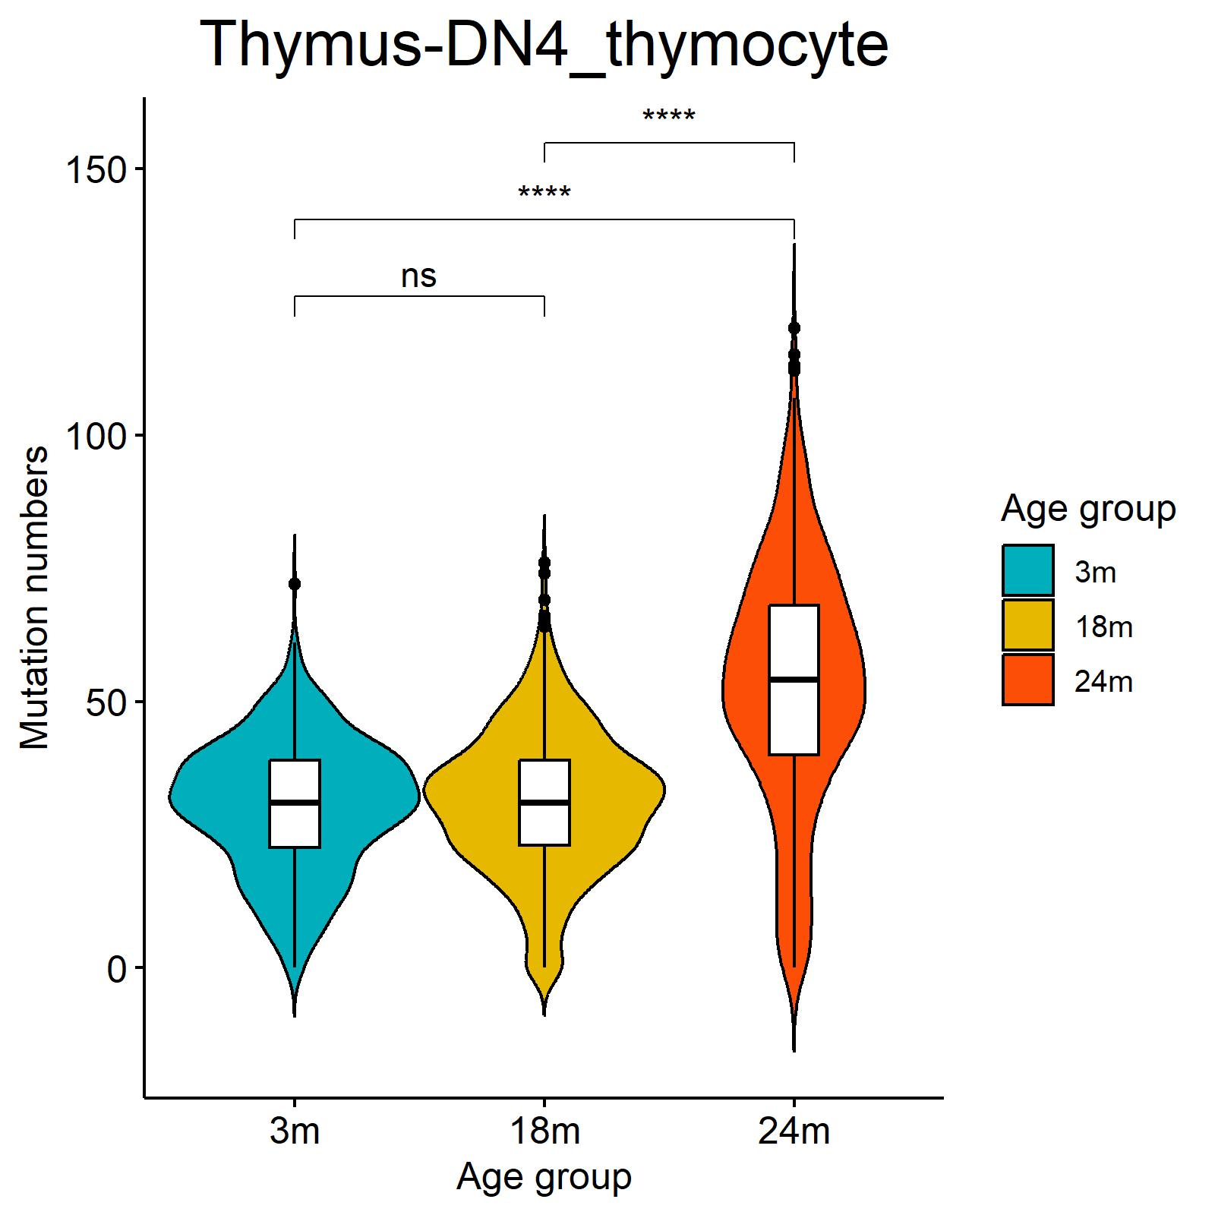
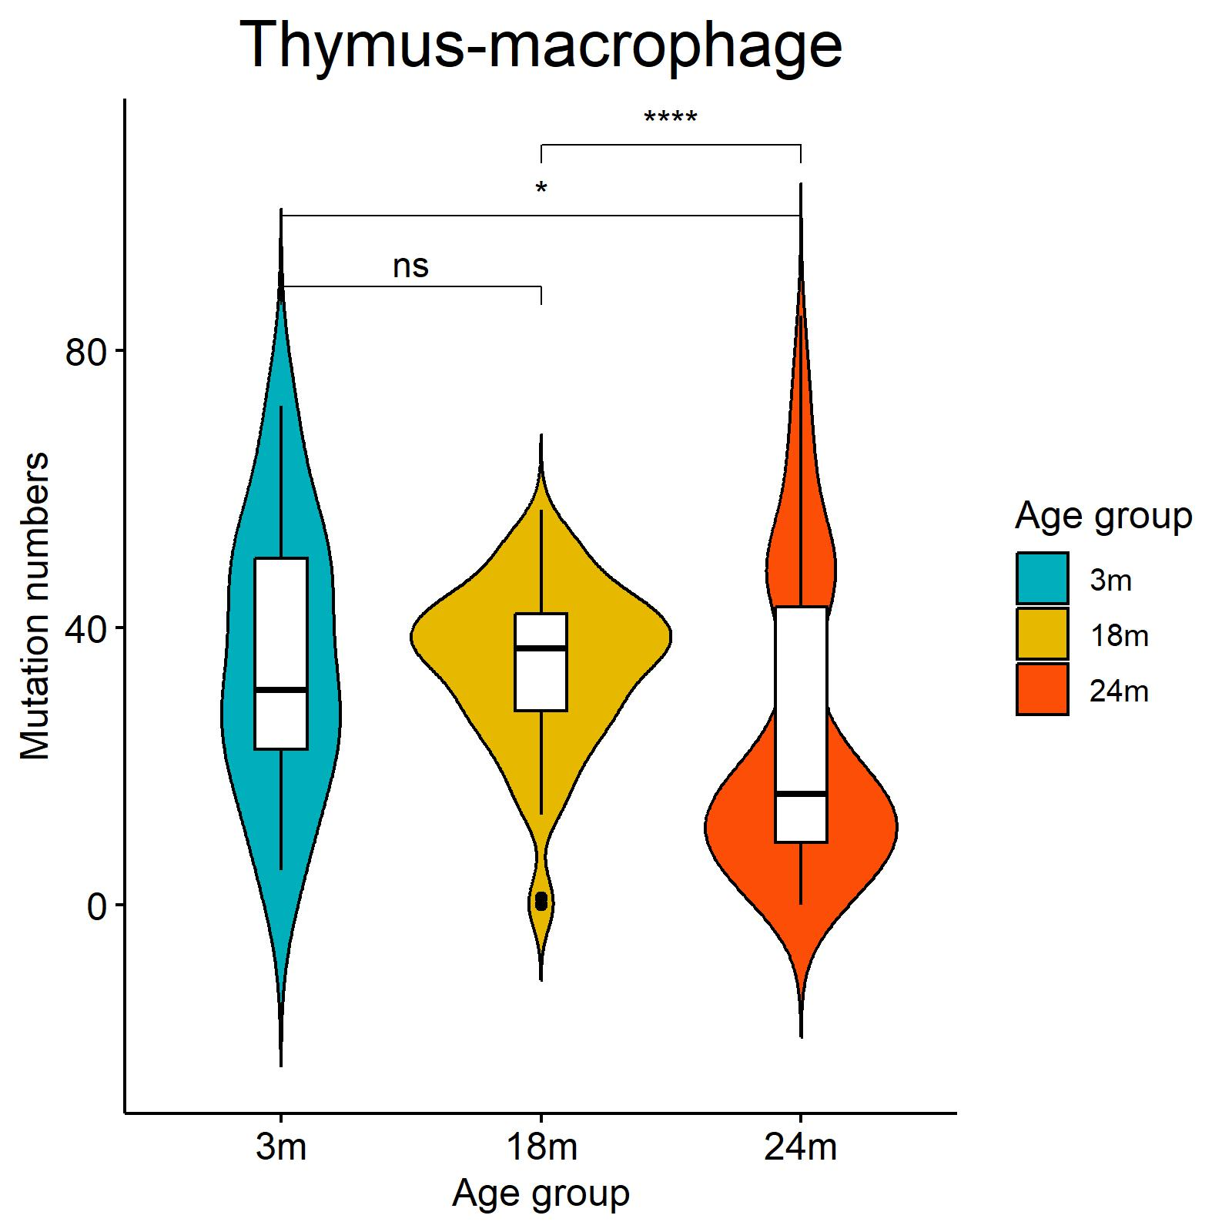
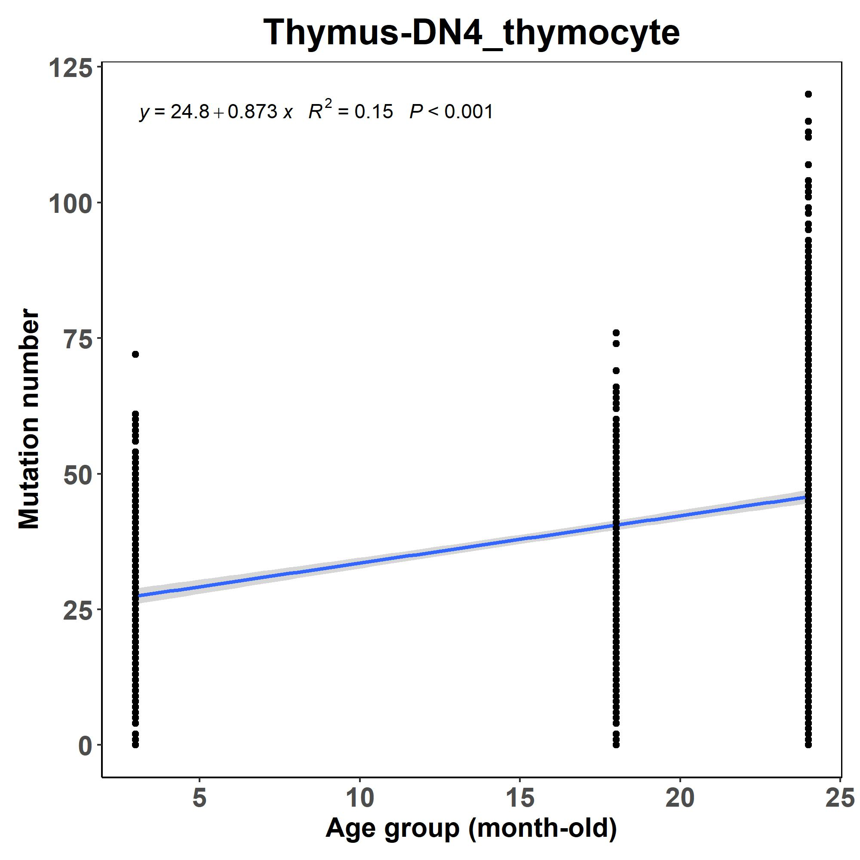
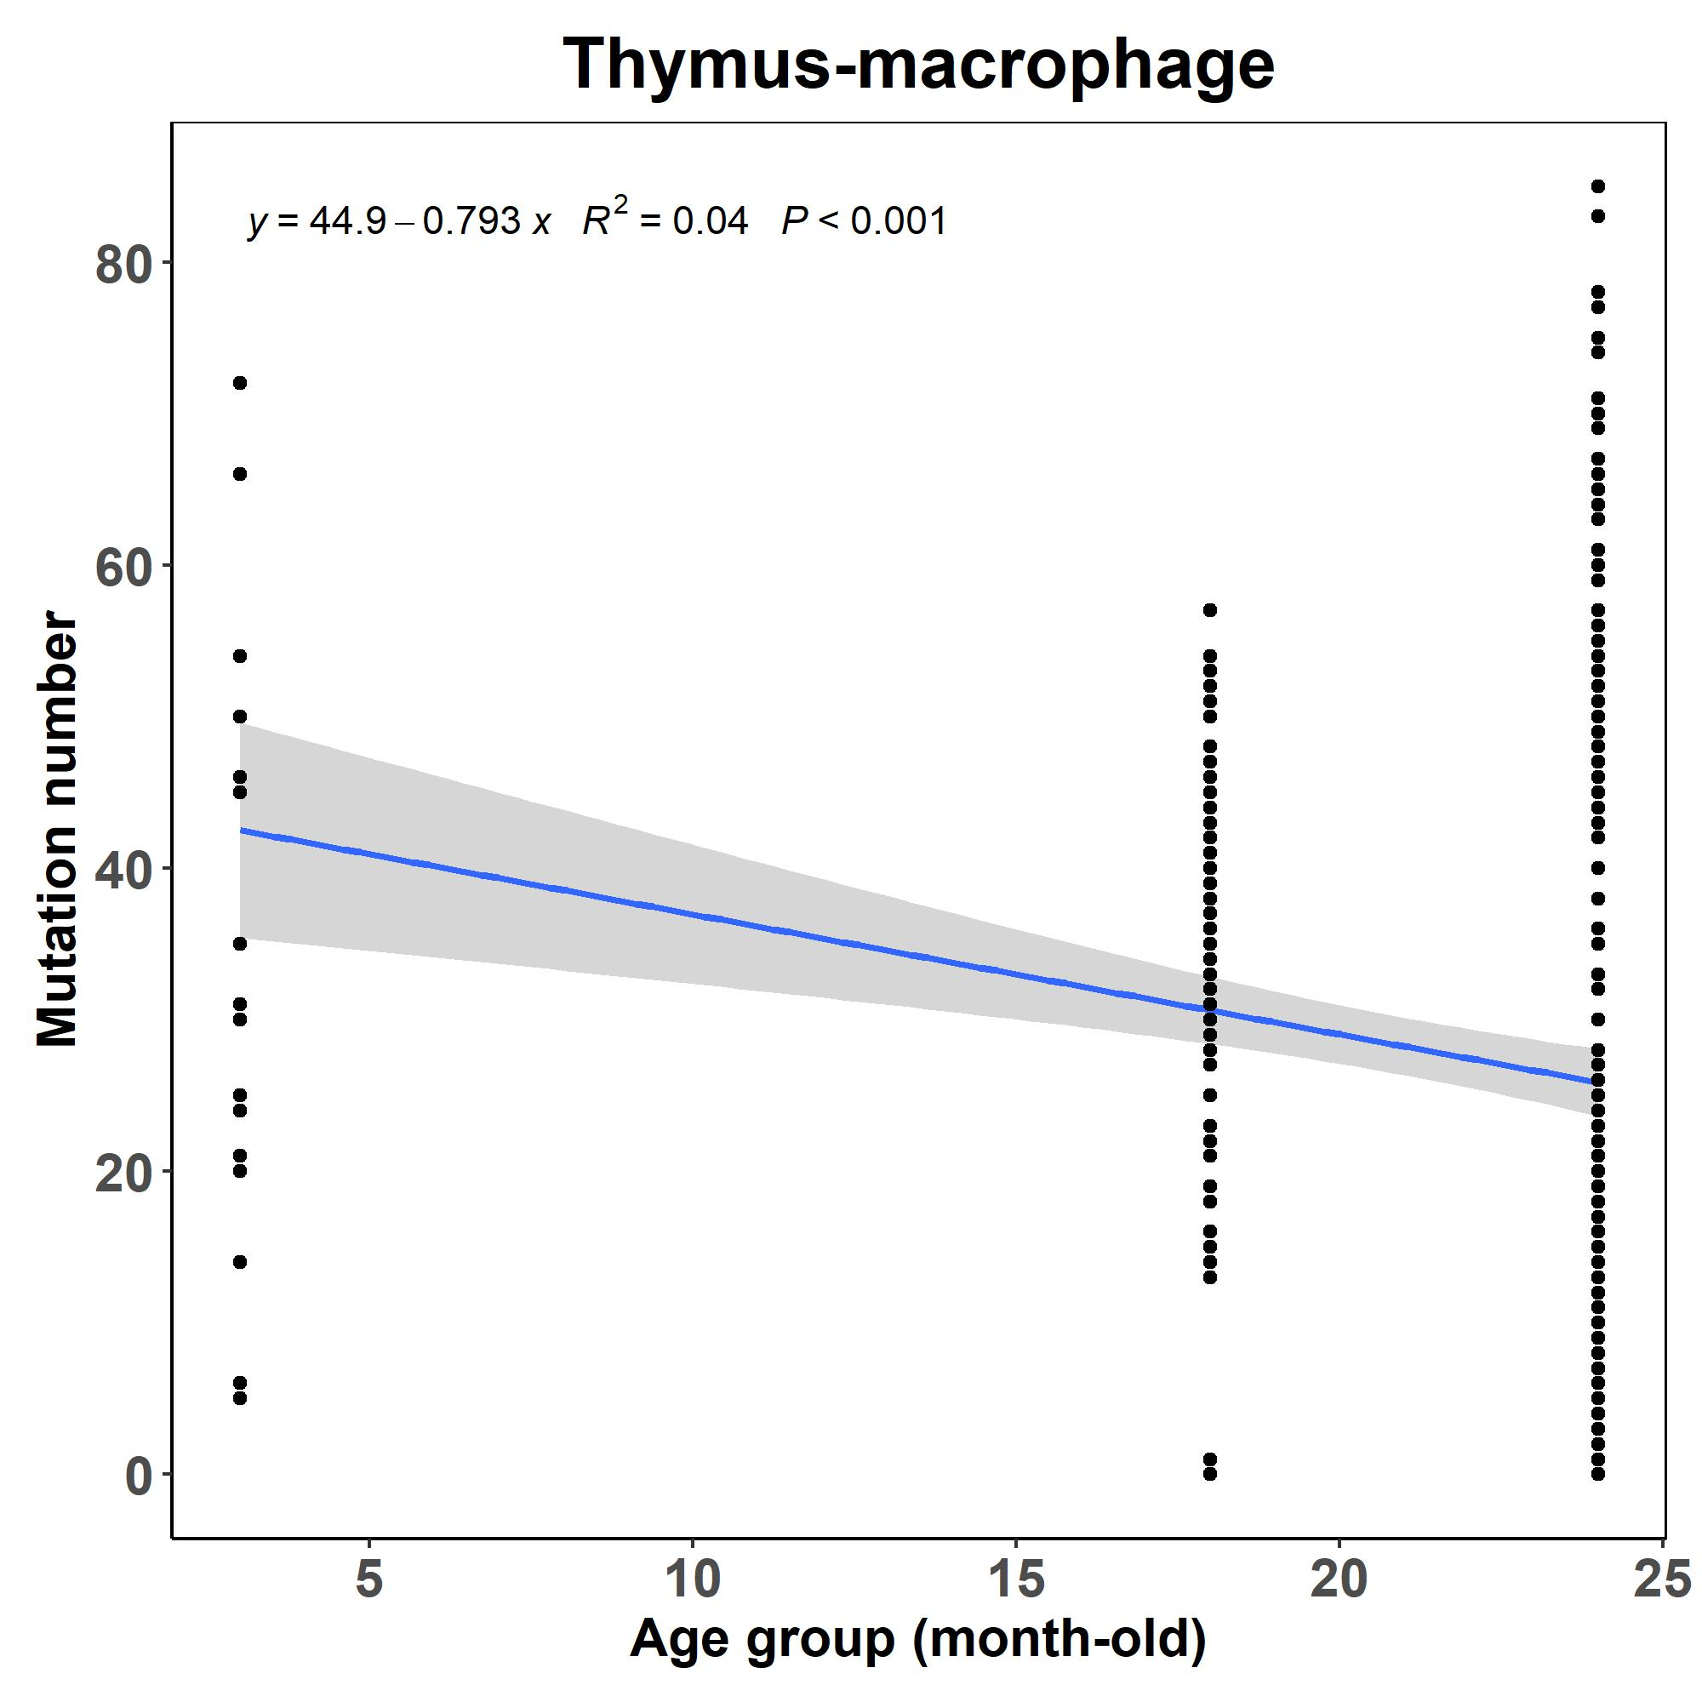
Results
Variation of RBP Mutation Rates Among Different Cell-types
Within the Same Tissue
The increasing rates of RBP mutation in different cell-types vary in Thymus during aging:
For DN4 thymocyte, the number of RBP mutations increases with aging.
For macrophage, the number of RBP mutations does not exhibit a clear trend with aging.

Slide 14
Conclusion
We constructed a RBP mutational landscape during aging using a large-scale scRNA-seq dataset.
The type and region of RBP mutations show moderate changes during aging.
The increasing rates of RBP mutations vary across tissues and cell-types.

Slide 15
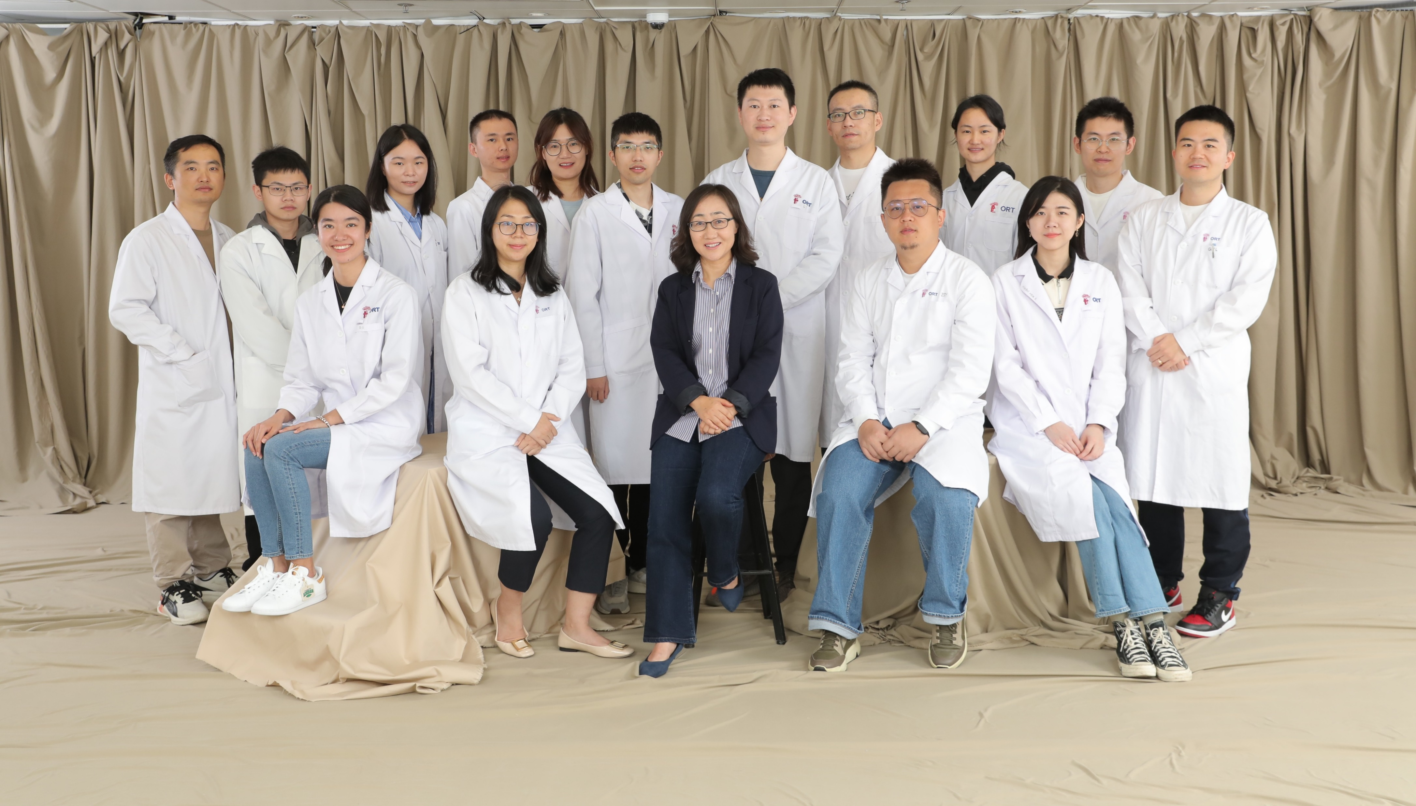
Acknowledgement
Professor Wang’s lab:
Dr. Xiaona Chen
Dr. Liangqiang He
Dr. Suyang Zhang
Dr. Yang Li
Dr. Yulong Qiao
Dr. Yi Jin
Qin Zhou
Xingyuan Liu
Xiaofan Guo
Ziliu Wang
Dr. Qiang Sun
Chuhan Li
Feng Yang
Gexin Liu
Yang Fu

